Slide 1
OPEN ACCESS TO SCIENCE AND RESEARCH AS PUBLIC GOOD AND THE STATUS OF REPOSITORIES IN SOUTH AFRICA
Lazarus Matizirofa
Knowledge Management Corporate, NRF
NELSON MANDELA METROPOLITAN UNIVERSITY
Open Access Seminar – 27 July 2015

Slide 2
NRF’s knowledge ecology

Slide 3
NRF’s core competencies
The core competencies are embedded in:
Leading-edge grant management systems;
World-class research evaluation and benchmarking practices;
Science and technology management experience;
State-of-the-art research platforms;
Specialised research capacity at the National Research Facilities;
Strategic information accumulation and dissemination capability;
Capacity to catalyse local and international science cooperation, networks and partnerships; and
Science advancement expertise and platforms

Slide 4
NRF’s membership to Global alliances
NRF is the only African research funder at the Global Research Council

Slide 5
OA Policies World Wide

Slide 6
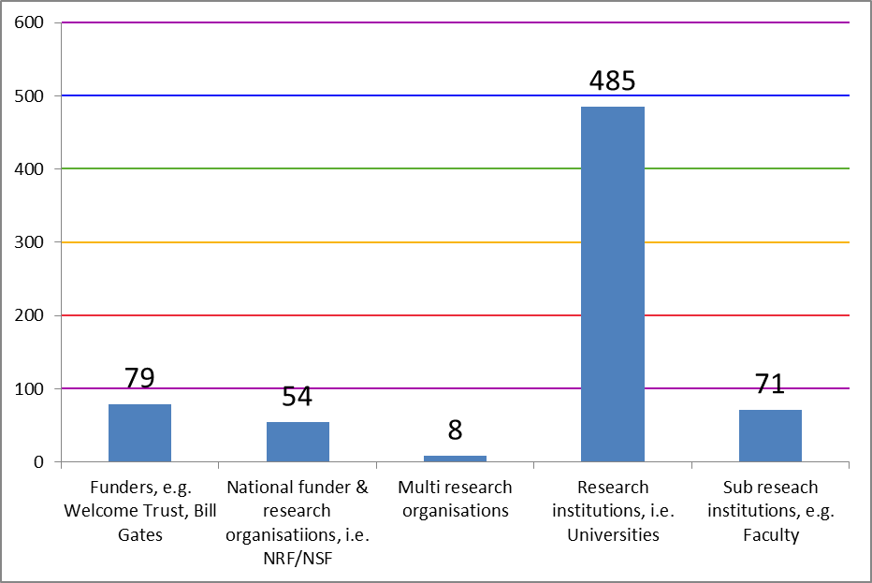
Funder mandates – Global perspective

Slide 7
NRF’s OA Statement ranking: COAR/SPARC
Joint COAR-SPARC conference, April 15-16, Portugal 2015 ranked the NRF’s OA Statement no. 5 globally
Based on the following recommendations
Must deposit
Cannot waive deposit
Must make item Open Access
Link to research evaluation
The NRF OA Statement is mandatory!

Slide 8
What NRF is expected to do!
By recommending/requiring OA to publicly funded research results
Ensure investment has optimal impact on science and society
Requires thorough monitoring of funded publications and related costs
Ensure research data whether already in existence/yet to be produced is accessible
research data “ factual records used as primary sources for scientific research…commonly accepted in scientific community necessary to validate research findings. A research data set constitutes a systematic, partial representation of the subject being investigated ”

Slide 9
NRF OA Statement reflection
Global Research Council/NRF
Funding agencies – important role in initiating & shaping OA transition
Success of Gold/Green Route depends on the understanding/readiness of the research community
The NRF recognises the importance of Open Access to science and research

Slide 10
What NRF OA Statement is about!
Not intended to apply to research publications/data gathered for the purpose of commercialisation of research outcomes, or
To research data that are the property of a private sector entity
Is not a statement for all research generated by public funds- but as one of the funders

Slide 11
What NRF OA statement is all about!
From 01 March 2015, research papers/datasets generated from research either fully or partially funded by NRF, should be deposited in institutional repository with an embargo period of no more than 12 months
NRF will not routinely check compliance with Chief Investigators – institutions are responsible through Designated Agents (DA’s)
Material published in respect of NRF funded research activity be included in repositories, non-inclusion provided in Final Grant Report by Cis

Slide 12
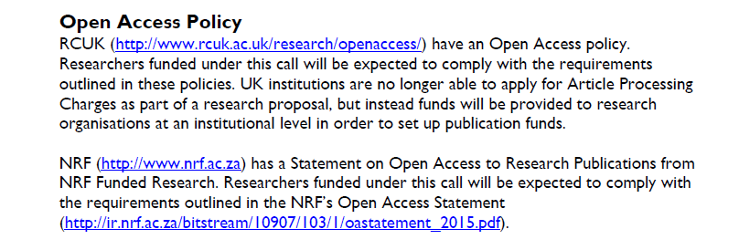
Example of joint funder OA requirement

Slide 13
NRF OA Statement: publications archiving
Open Access (journals & books)
Publisher PDFs/ HTML
Authors’ manuscripts
Pre-prints/Post-prints

Slide 14
NRF OA Statement : Datasets
Data Publication and Citation
NRF/SAEON is registered with Datacite as the national DOI agent for data publication and citation through a DataCite License
Researchers can register for datasets DOIs from NRF/SAEON

Slide 15
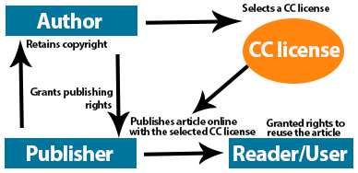
NRF recommends author retains copyright

Slide 16
Role of NRF as a funder
Develop funder open access policy/statement
Address copyright
Cover publication fees
explains reasons to have research results made openly available
Important guidance for all grantees
Funding guidelines modified in a manner that prevents researchers to transfer copyright exclusively to a publisher
Provide legal basis for deposit of research articles in an OA repository
Within a grant proposal, allow grantees to apply for an earmarked budget to cover publication fees, etc.

Slide 17
SA transition to funders’ OA policies: Stakeholders
NRF recognised institutions
Universities
Research libraries
Scholarly associations
Publishing houses
All MUST adhere to funders’ OA mandates

Slide 18
SA transition to OA: Berlin Declaration
Signatories (SA) to date
30.09.2010 University of Stellenbosch
27.05.2011 University of Johannesburg
06.10.2011 Library and Information Association of South Africa
01.11.2011 University of Cape Town
21.05.2012 University of South Africa
25.09.2012 Academy of Science of South Africa
22.10.2012 University of KwaZulu-Natal
09.11.2012 University of the Witwatersrand
20.05.2013 Durban University of Technology
21.10.2013 Tshwane University of Technology
23.10.2013 University of the Western Cape
24.10.2013 Rhodes University
11.02.2014 North-West University
20.10.2014 National Research Foundation of South Africa
http://openaccess.mpg.de/Berlin-Declaration

Slide 19
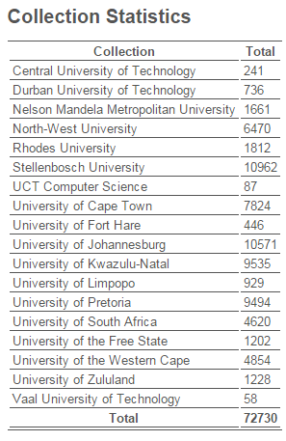
Other NRF Databases
Current & Completed Research Projects
NRF Funded Projects Database
South African Professional Associations Database
Data Resources in Africa
Digital Initiatives Register and Heritage Repository
South African National Antarctic Programme (SANAP) Bibliographic database
RIMS
South African Data Archive
Source: ETD stats -http://www.netd.ac.za/ (24/07/2015)

Slide 20
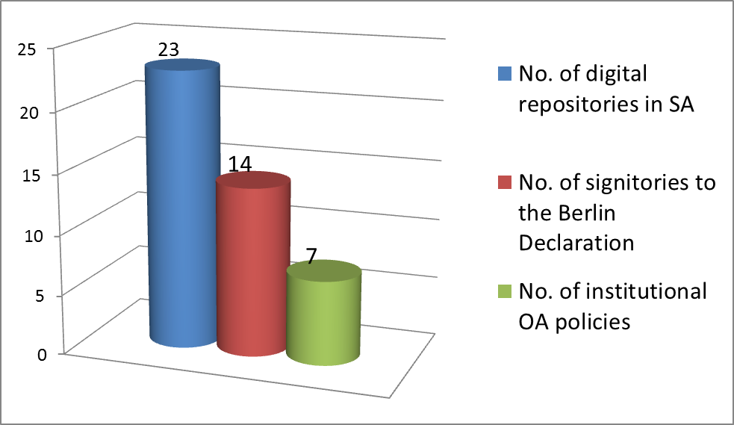
NRF OA Statement survey: 2015
The NRF conducted a survey and a stakeholder workshop (primarily HEIs, National Facilities, and Research Councils)

Slide 21
NRF OA Statement Impact Survey
Which of the following policies have been approved at your institution?
Answer Options | Response Percent | Response Count
OA Mandate/statement | 22.2% | 4
OA Policy | 38.9% | 7
IR Policy | 44.4% | 8
Digitisation policy | 5.6% | 1
Intellectual property policy | 72.2% | 13
Preservation policy | 11.1% | 2
Other (please specify) |  | 8
answered question |  | 18
skipped question |  | 5

Slide 22
Benefits of Funder OA mandates to HEIs
Universities
visibility and impact for research outputs
Long term curation and preservation of all funded research outputs
Supplementary information resources to subscription and/or pay per view fees, which creates a significant barrier to the widespread dissemination and use of research knowledge
National Research Foundation
Open access is expanding the broader concept of Open science
OA repositories have become indispensable for managing, tracking, and providing access to the full range of outputs produced through funded research

Slide 23
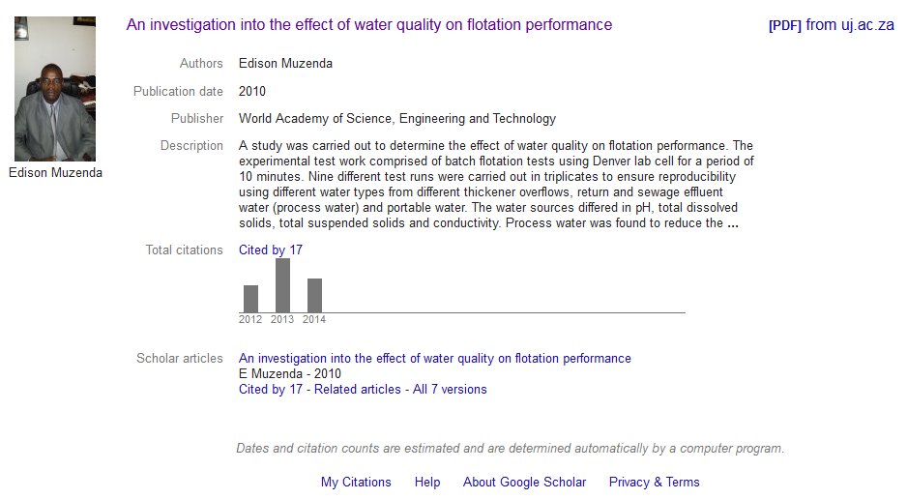
Benefits of OA (IR) to a researcher

Slide 24
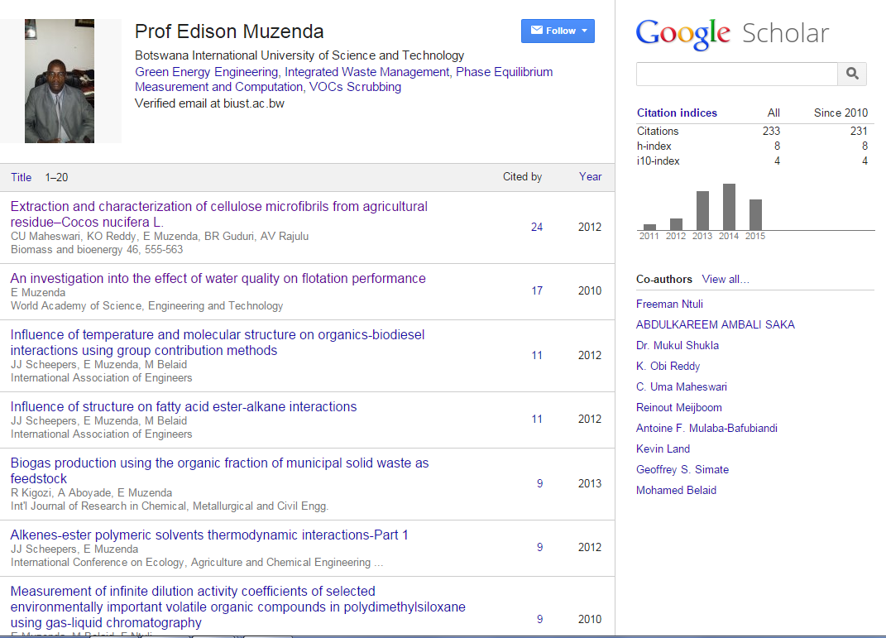
Researcher’s visibility, citation impact

Slide 25
Conclusion: Challenges & Opportunities
Current priorities for South African repositories alignment
Policies (and Laws): harmonise requirements across policy
environment, limiting embargo periods to 12 months
Technical and semantic standards: adopt common metadata
standards, elements of vocabularies, incorporate ORCID IDs into repositories, DOIs (Datasets)
Services: support, adopt, and develop shared services,
manage research data and linking data to publications

Slide 26
References
GRC (2015) Evolution or revolution? Publishers’ perceptions of future directions in research communications and the publisher role - A report commissioned by Research Councils UK for discussion among the Global Research Council
COAR (2015) Promoting Open Knowledge and Open Science: Report of the Current State of Repositories.
Review of Implementation of the Global Research Council- Action Plan towards Open Access to Publications: Main Outcomes of the 2014 Survey of GRC Participating Organizations
NRF Open Access Statement, 2015

