Slide 1


Open Scholarship for the future of research and teaching and learning
Reggie Raju
UCT Libraries

Slide 2
Discussion outline
Pillars of open scholarship
Significance of OA for researchers
  Changing information landscape
  The researcher in a global university
  The researcher seeking improved impact
Open Educational Resources
  OER as a social inclusion tool
  The two streams of OERs
  MOOCs
Conclusion

Slide 3
Pillars of open scholarship
Notes:
The first thing I need to do is tease out the concept of ‘Openness’ which is much broader than open access. The openness movement or the open scholarship movement has three significant pillars namely, open source, open access and open educational resources. This open scholarship trilogy accentuates the need for the continuance of the cooperative relationship between open source, open access and open educational resources.

Slide 4
Pillars of open scholarship
Open source uses communities of practice and crowd sourcing
refers to the creation of software in which the source code is available, free of charge, to the general public for use and/or modification from its original design
Open source was developed in the technology community as a counter to proprietary software owned by corporations
Notes:
The forerunner in the trilogy is open sources which gained momentum using communities of practice and crowd sourcing as its golden threads.
Open source refers to the creation of software in which the source code is available, free of charge, to the general public for use and/or modification from its original design. Open source code is typically created as a collaborative effort in which programmers improve upon the code and share the changes within the community. Open source developed in the technology community as a response to proprietary software owned by corporations

Slide 5
Pillars of open scholarship
Open access refers to free access to scholarly information for the end user
founding philosophy of the movement was the sharing of scholarly literature for the furtherance of research
philanthropic philosophy, that is, sharing of research output for the benefit of society and the research community
improves visibility of research output
Vendors constructed a new business model – APCs
Notes:
Open access refers to free access to the scholarly information to the end user. The OA movement originated as a direct response to the subscription crisis, that is, the exponential increase in the cost of journal subscriptions on the back of decreasing acquisition budgets. The founding philosophy of the movement was the sharing of scholarly literature for the furtherance of research. It is accepted that the primary purpose of dissemination of research is for the generation on new knowledge. The origins of OA were underpinned by a philanthropic philosophy, that is, sharing of research output for the benefit of society and the research community. However, it was not long after the initiation of OA that improved visibility of research output began to gain prominence and began to overshadow the original philanthropic purpose. Vendors, recognizing the visibility imperative, constructed a new business model through article processing charges which met the demand for improved visibility: the pendulum now began to swing back to the vendor.

Slide 6
Pillars of open scholarship
Open Educational Resources refer to teaching and learning materials that are in the public domain
founding philosophy of the OER movement was the improvement of the quality of education
Notes:
The third segment in the trilogy is open educational resources. Open Educational Resources are teaching and learning materials that are in the public domain or have been released under an intellectual property license. OERs by its very nature means that anyone can legally and freely copy, use, adapt and re-share them. The founding philosophy of the OER movement was the improvement of the quality of education and the strengthening of the educational system, especially in the developing world.

Slide 7
Pillars of open scholarship
Notes:
At the core of the open scholarship movement is society or the general public. A strong public education system increases the pipeline for a growth of the research community: improved access to content contributes to an increase in research output. An output of a research process is new source code for new software – cycle continues with the point of return or the greatest beneficiary is society.

Slide 8

Significance of OA for researchers
Changing information landscape

Slide 9

Significance of OA for researchers
Changing information landscape
Importance of OA is split:
  Access for the furtherance of research
  potential impact and improved visibility of the research
Google will add value to the discoverability and accessibility of open research content
  improve the research impact through increased usage and citation
In the main, if the researcher can see it but cannot get access then it does not exist as the researcher will seek alternatives
Despite the fact that scholarly information is ubiquitously visible, if it cannot be discovered and accessed, it will negate its capacity to impact the furtherance of research
Notes:
It is commonly accepted that OA is split into access to enhance the furtherance of research and potential impact and improved visibility of the research. However, they are not mutually exclusive as one will always have an impact on the other and vice versa.
The exponential increase in subscription costs has dramatically influenced, negatively, the distribution of journals. The knock-on effect of the subscription increase is that articles within the journals will lose a proportion of their potential research impact (in terms of usage and citations) as the journal distribution channel is continuously constricting: more and more journals are becoming less accessible due to this increase in costs of subscription against the backdrop of decreasing library acquisition budgets. The fundamental purpose of OA is to reverse this trend (that is, growing inaccessibility of content) through improved discoverability, visibility and accessibility of research output.
There is empirical evidence that reveals that Google is the starting point for most research conducted. Given one of the principle requirement of OA is that content be available in electronic format, Google will add value to the discoverability and accessibility of open research content. This discoverability and accessibility will significantly improve the research impact through increased usage and citation. In an era of a glut of information, it is imperative that ‘authentic’ scholarly literature is at the top of the list of Google and other search results. It is generally accepted that if content is not readily available or does appear high the list of search results, then it is deemed to be non-existent. And, if the researcher can see it but cannot get access then it does not exist as the researcher will seek alternatives.
Despite the fact that scholarly information is ubiquitously visible, if it cannot be discovered and accessed, it will negate its capacity to impact the furtherance of research. If you ae not in the Google space and not accessible then your research does not exist.

Slide 10

Significance of OA for researchers
The researcher in a global university
Global University

Slide 11

Significance of OA for researchers
The researcher in a global university
Academic researchers are contributing to a global university
Academic institutions are supporting their researchers publish in gold OA forums (including Diamond OA)
Authors publish their articles in journals where there is no cost to authors and to the end users
Clobridge (2014): “We have reached the tipping point and appear to have more than half of all scholarly, peer-reviewed research freely accessible via repos­itories, websites, or publishers' platforms”. For the percentage that is still "closed" to researchers, the prediction is that will decrease in coming years and should diminish at an even greater rate than currently
Researchers who are not publishing in OA access forums - their contribution to the global research community is minimized

Slide 12
Significance of OA for researchers
The researcher seeking improved impact
Citations:
  Authors are now driven by larger reading audience and improved citations
  Citations are the only public statement of intellectual recognition of the author
  Davis (2006): “Having work cited is therefore an incentive for scientists, and in many disciplines, it forms the basis of a scientist’s evaluation.”
There is no better way to communicate peer-reviewed scientific results than to make it freely available on the Internet (Mullen 2008)

Slide 13


A rapidly growing mantra in the online era

Slide 14



Slide 15
Open Educational Resources
Olcott (2012): OERs have emerged as one of the most powerful resources to transverse the global education landscape in the past century
UNESCO definition: sharing of educational resources purely for developmental purposes
Two key drivers
  marketing and public relations
  improvement in the quality of teaching and learning

Slide 16


Open Educational Resources
UK government views OER as an instrument, in its social inclusion agenda for widening learners’ access to higher education
The Indian government: Our success in the knowledge economy hinges to a large extent on upgrading the quality of, and enhancing the access to, education. One of the most effective ways of achieving this would be to stimulate the development and dissemination of quality Open Access (OA) materials and Open Educational Resources (OER)”
Social inclusion

Slide 17
Open Educational Resources
The two streams of OERs
Massive Open Online Courses (MOOCs) - free and scalable online higher education courses
Brain child of Downes and Siemens
Siemens (2013) voices his concern about the direction that MOOCs has taken
MOOCs ‘open’ in only one respect and that is open enrollment
New (2014) - many universities use MOOCs as a marketing tool for the increase in visibility of the institution and to drive student recruitment

Slide 18
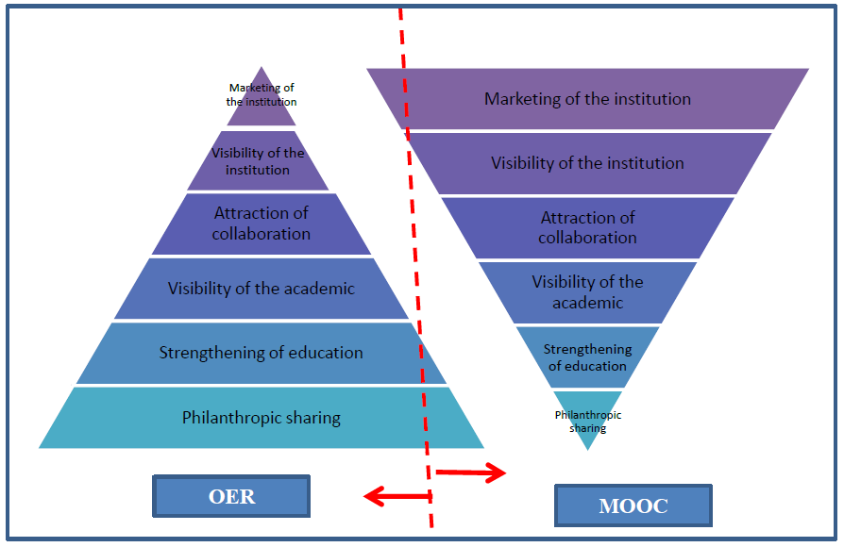
OERs vs MOOCs

Slide 19
Conclusion
The future of research is intrinsic woven in the open scholarship movement
The growth of research and its dissemination is a significant part of the OA fabric
Currently the only benefit of OER is philanthropism
Open scholarship is the future – researchers not engaging with it do so at their peril

Slide 20
Thank you!
Reggie.raju@uct.ac.za

