Slide 1
Tracking & Monitoring Research output, Trends & Evaluation with InCites
Melissa Badenhorst
WorldWide Information Services
melissa.badenhorst@wwis.co.za

Slide 2
Measuring impact

Slide 3
InCites: Benchmarking & Analytics Providing Context for Measuring and Demonstrating Excellence
Reputation management
Showcase Research Strengths
Comparison with Peers
Identify Experts
Strategic management and investment
Attract Funding
Demonstrate Impact
Manage Research Portfolios
Standardized Reporting and Management
Identify Research Outputs
Integrated Research Management
Track Trends and Growth
Notes:
Currently research evaluation is the most reliant on external information sources and benchmarks and least well defined in terms of regulatory, practice, or regional drivers
There are various ways to measure and manage research – all important and all connected to an overall research management strategy
But these involve analyzing a variety of data points and often require new metrics or indicators
Additional information and data sources provide context for a multidimensional approach to assessment. This can include:
University Data – ie HR information
Faculty Data – ie courses taught
Funding Data
Reputational Data
Citation Metrics

Slide 4
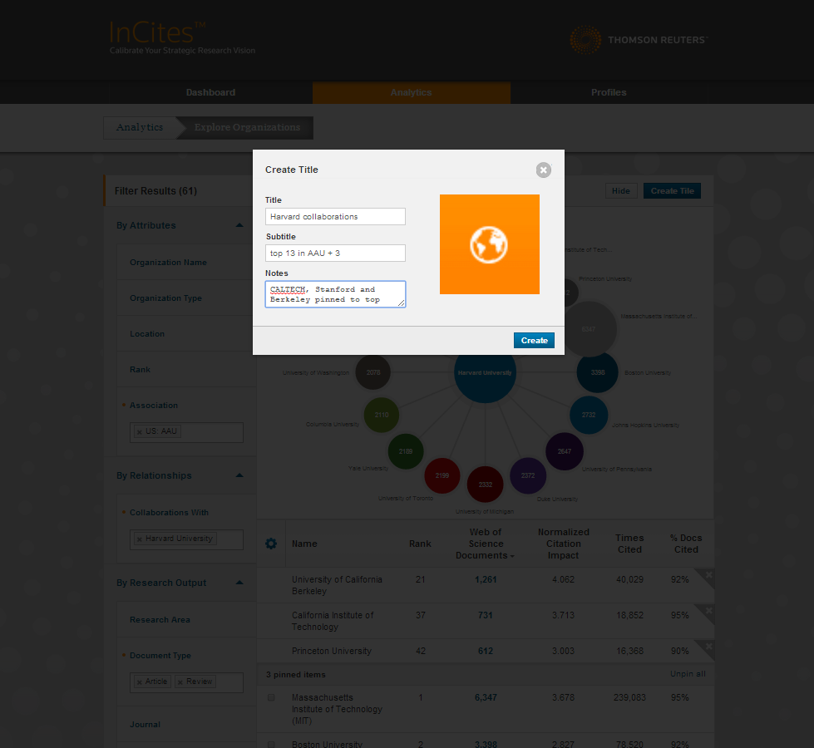
Analyzing Collaborations to Inform Strategic Decisions

Slide 5
Benchmarking & Analysis

Slide 6
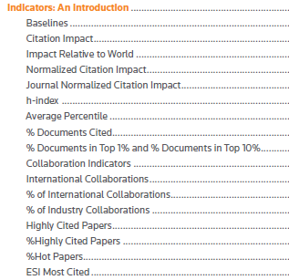
Multiple indicators

Slide 7
NMMU – Measuring output & benchmarking performance
Notes:
Measuring the impact
# of citations

Slide 8
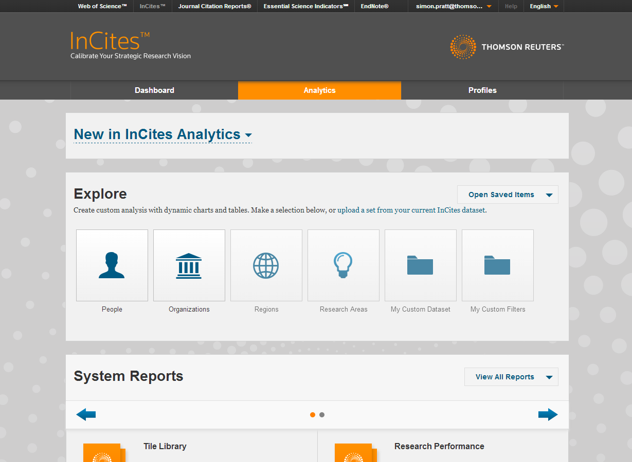
Access all your resources from the top menu.
Instantly access any service and seamlessly link between them.
All resources rely on the same data sources for consistency and comparability.

Slide 9
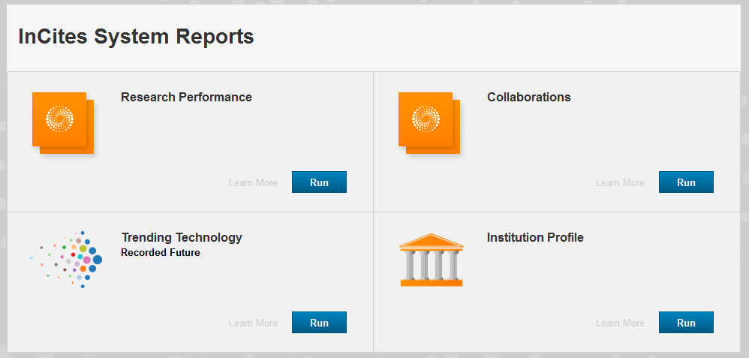
SYSTEM REPORTS

Slide 10
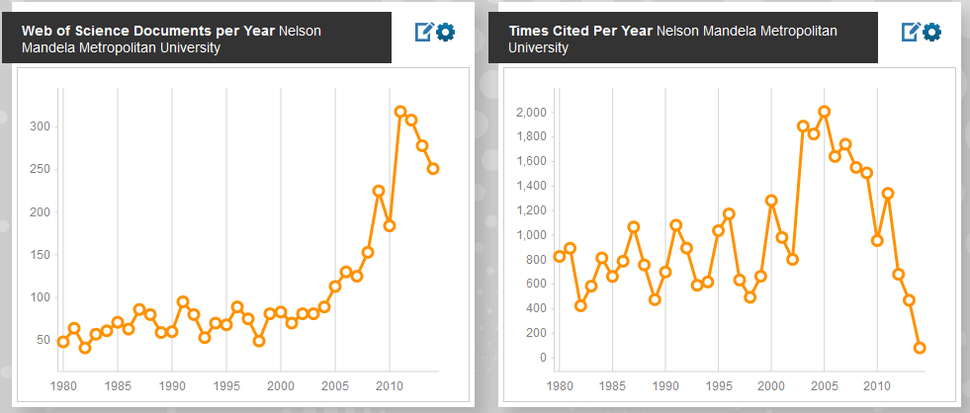
NMMU Research Performance Overall

Slide 11
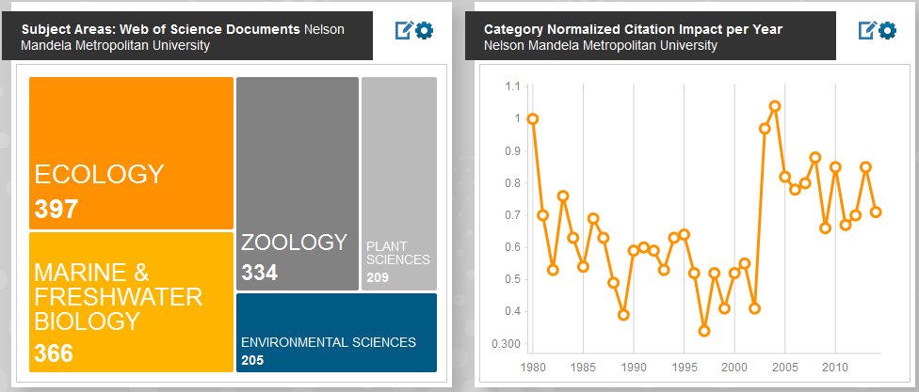
NMMU Research Performance Overall

Slide 12
System Reports: Collaborations

Slide 13
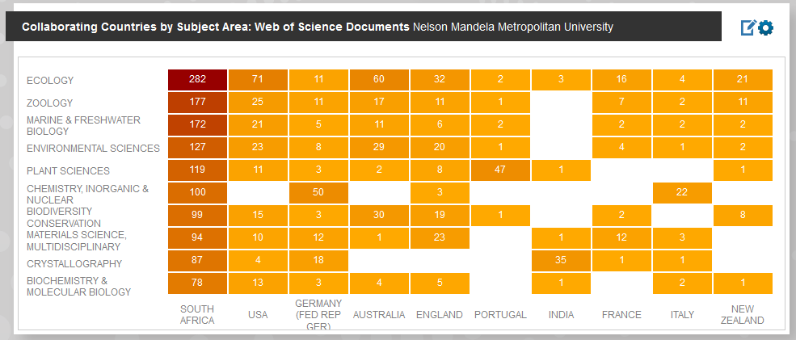
System Reports: Collaborations

Slide 14
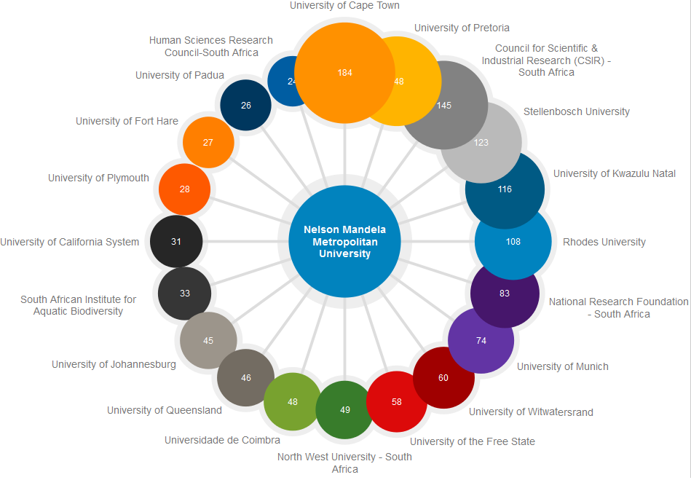
System Reports: Collaborations

Slide 15
While the interface is slightly different, you will find way more angles to work with
To decide which section you should use and in which situation, you need to keep in mind that “People”, “Organisations”, Regions”, “Research Areas”, “Journals”, will be the end result and not the limiters
Notes:
The official InCites environment only provides us with access to the “People” and “Organizations” sections.
In QA you will also get access to:
Regions: (This could be compared to “national comparisons” in IC1) it allows you to work on national levels.
Research Areas: This section allows you to select specific research areas and use that angle to generate reports.
Journals: This will allow a user to drill into the bibliometric analysis of specific journals or groups of journals, and run comparisons, with and without using specific filters.

Slide 16
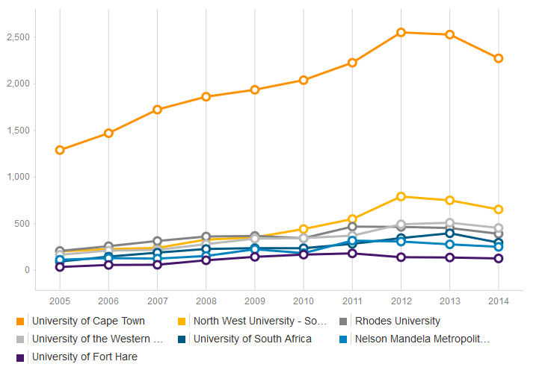
NMMU Compared: Nr of WoS CC papers overall

Slide 17
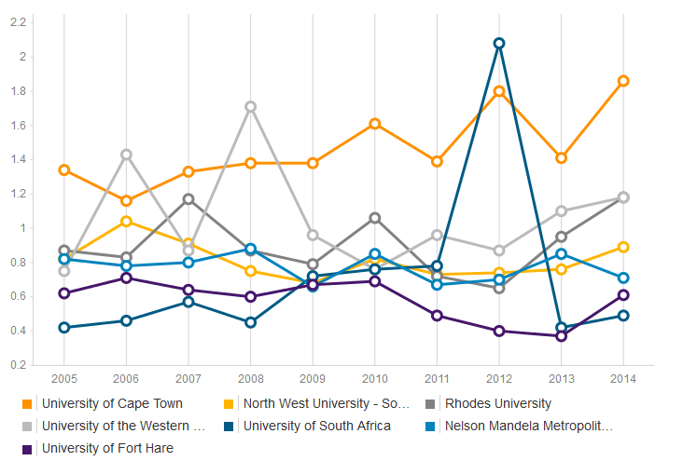
Normalized Citation Impact: NMMU Compared

Slide 18
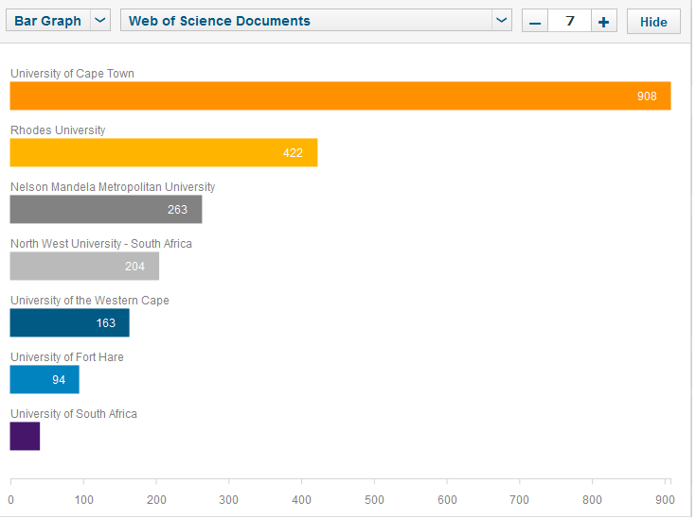
Number of papers published: NMMU Compared in Environment/Ecology

Slide 19
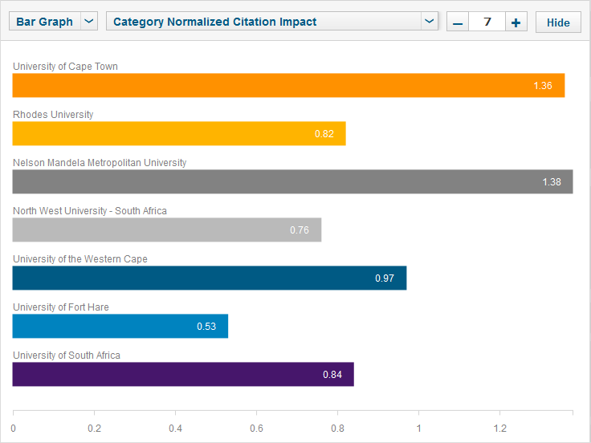
Normalized Citation Impact: NMMU Compared in Environment/Ecology

Slide 20
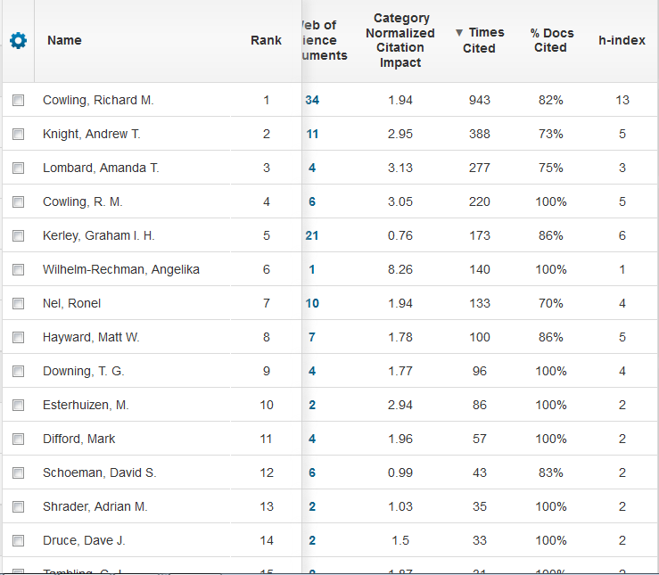
NMMU contributing authors in Environment/Ecology

Slide 21
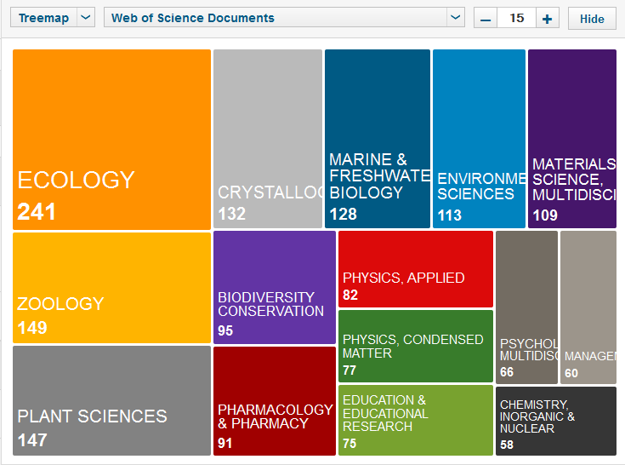
Most Productive Areas 2005 - 2014: NMMU

Slide 22
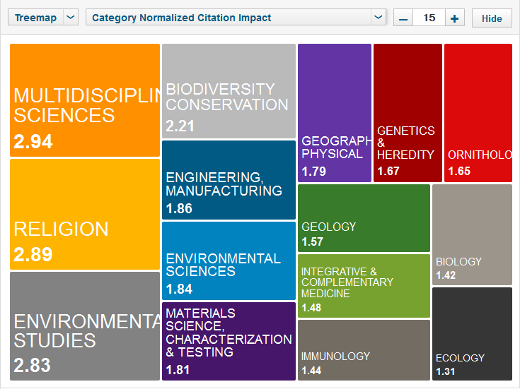
Areas with highest impact: NMMU 2005 - 2014

Slide 23
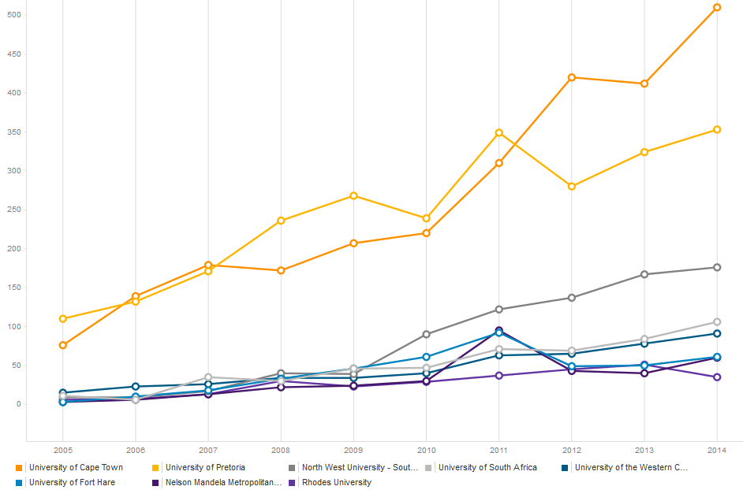
NMMU Compared: Nr of WoS CC OA papers overall

Slide 24
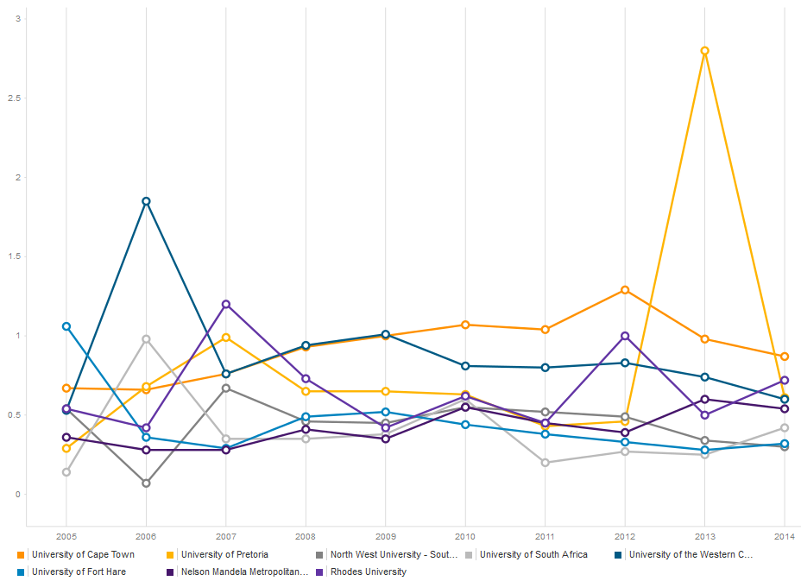
Normalized Citation Impact in OA: NMMU Compared

Slide 25
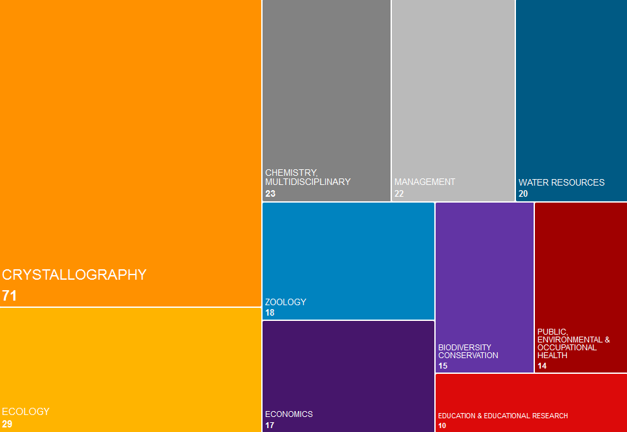
Productivity in WoS CC OA: NMMU

Slide 26
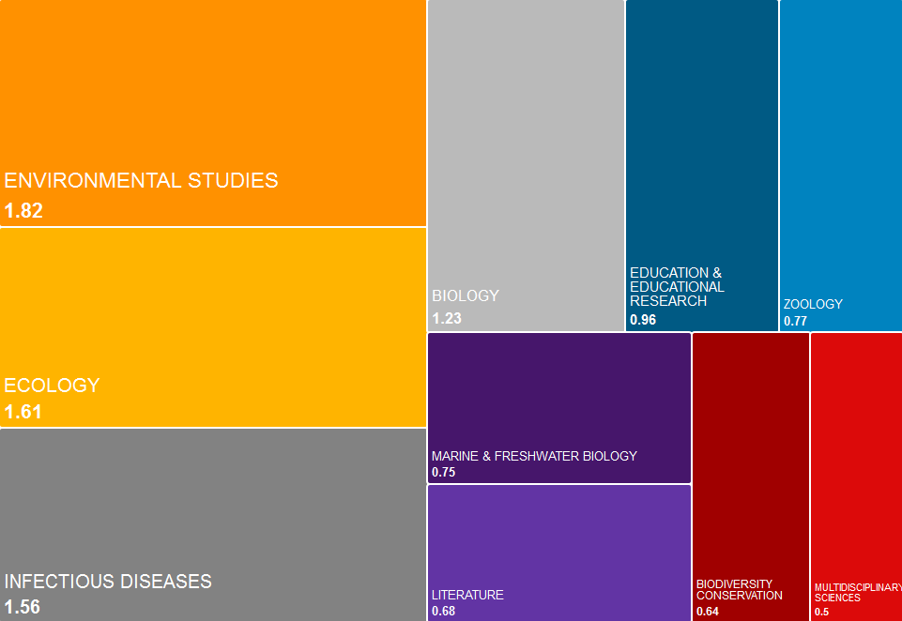
Normalized citation Impact by Subject Area: NMMU OA

Slide 27
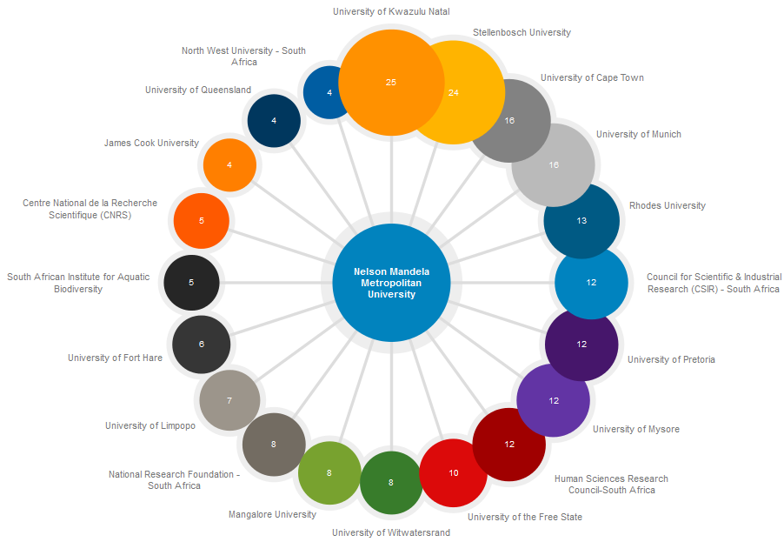
NMMU Collaborations OA

Slide 28
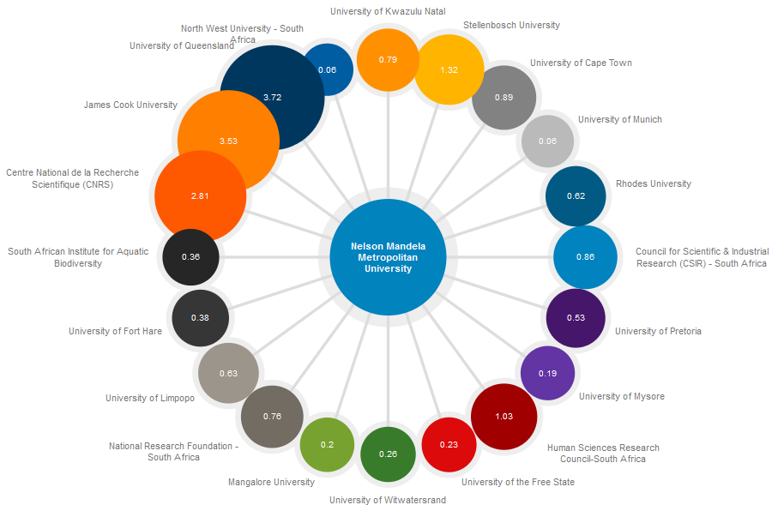
Which of these collaborations had the highest impact?

Slide 29
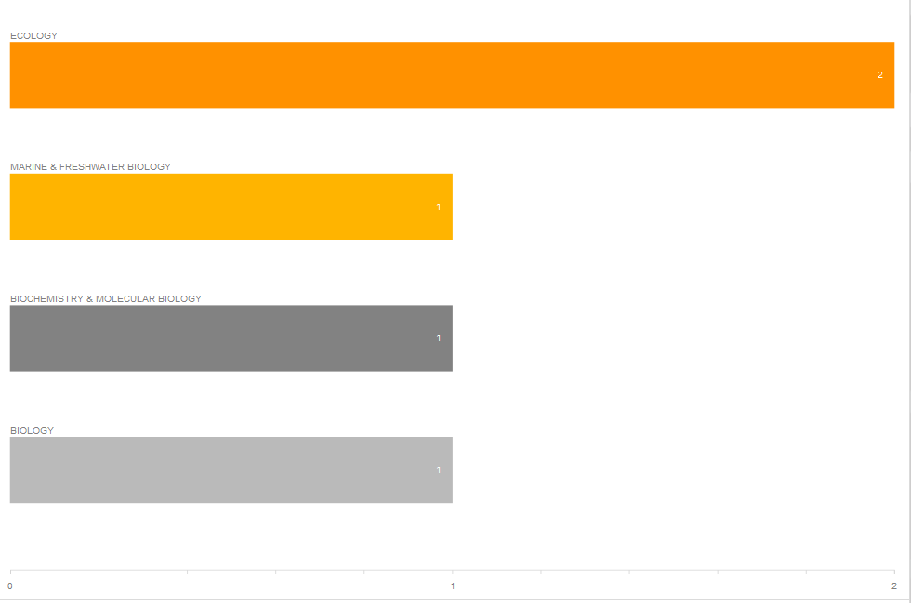
Research Areas in which NMMU collaborates with Univ Queensland in OA

Slide 30
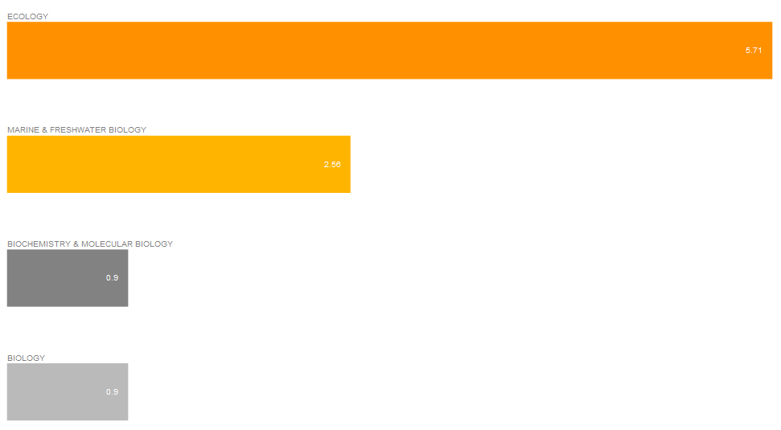
Impact by Research Areas in which NMMU collaborates with Univ Queensland in OA

Slide 31
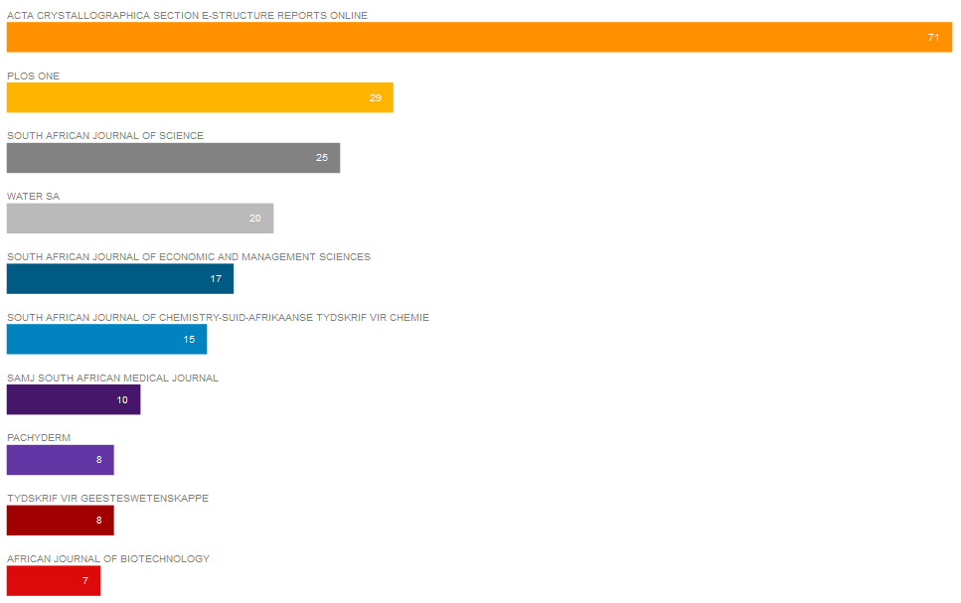
Journals in which NMMU publish OA

Slide 32
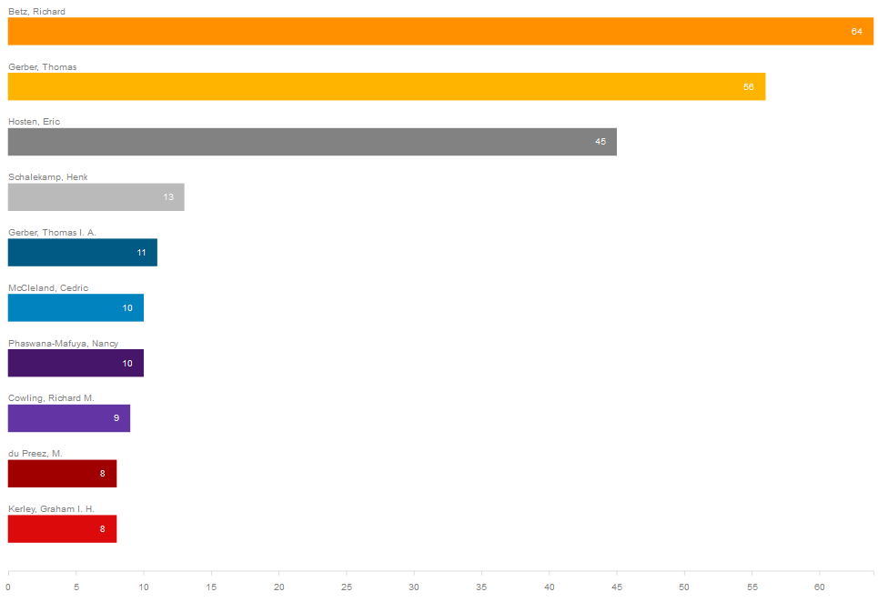
NMMU Authors that publish OA

Slide 33
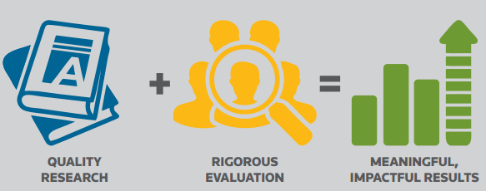
Formula for success

Slide 34
Thank you!

