Slide 1
Open access
How Elsevier Support’s OA
Mohamed Kamel – Africa Regional Director

Slide 2
This presentation includes the following:
What is open access?
Elsevier and open access
Gold open access
Green open access
Institutional repositories
Access to research initiatives

Slide 3
What is open access (OA)?
Types of open access and
its use around the world

Slide 4

What is open access?
Gold Open Access
  Final version of an article is immediately accessible to everyone
  Cost of publishing is recovered upfront
    Typically as an Article Publishing Charge (APC)
Green Open Access
  A version of a subscription article is made freely available
  Relies on the subscription model to continue to operate
    Usually after an embargo period
    Normally a draft copy of the article but can also be the final version

Slide 5
Total article growth by journal business model
In 2017 there were an estimated 2.2 million subscription and 0.5 million open access articles published worldwide.
  Subscription content
  83% share of total articles in 2017
Open access content
APC-based fully gold and hybrid open access articles is 15% share of total content in 2017
All gold open access, including subsidized articles, is 17% share of total content.
Elsevier perspective
In 2017, Elsevier published over 430,000 articles
  Includes over 27,000 open access articles

Slide 6

Elsevier and open access

Slide 7
Elsevier and open access
Gold open access
Green open access
Leading gold open access publisher
Published over 170 fully open access journals and over 1,850 hybrid journals
Published over 27,000 open access articles in 2017
Choice of either a commercial (CC BY) or non-commercial (CC-BY-NC-ND) user license.
Article publishing charges (APCs) range from ~$150 to ~$5000 (US Dollars)
Largest publisher enabler of green open access
All 2500+ journals provide a green open access option
Participate in CHORUS and support pilots with institutions and international funders
Free API program to fuel repositories
Share link service provides 50 days free access to recently published research
Open archives in over 110 journals, including Cell Press titles after 12 months

Slide 8


















Working with funders to empower open access
We work together by:
Optimizing the publication process to make authors aware of how to comply with funder mandates
Providing an API program to fuel institutional repositories
Supporting funders and institutions participating in CHORUS
Providing customized reporting, monitoring and tailored invoicing for institutions
Training customer service staff to help researchers understand funder and institutional OA policies and how to comply
Notes:
Elsevier is proactively working with funding bodies to develop agreements which make it easy for authors to publish in Elsevier journals.
These agreements help to implement open access policies in a sustainable way for both the academic community, our journals and the wider public.

Slide 9
Gold open access publishing
Process, types and usability

Slide 10
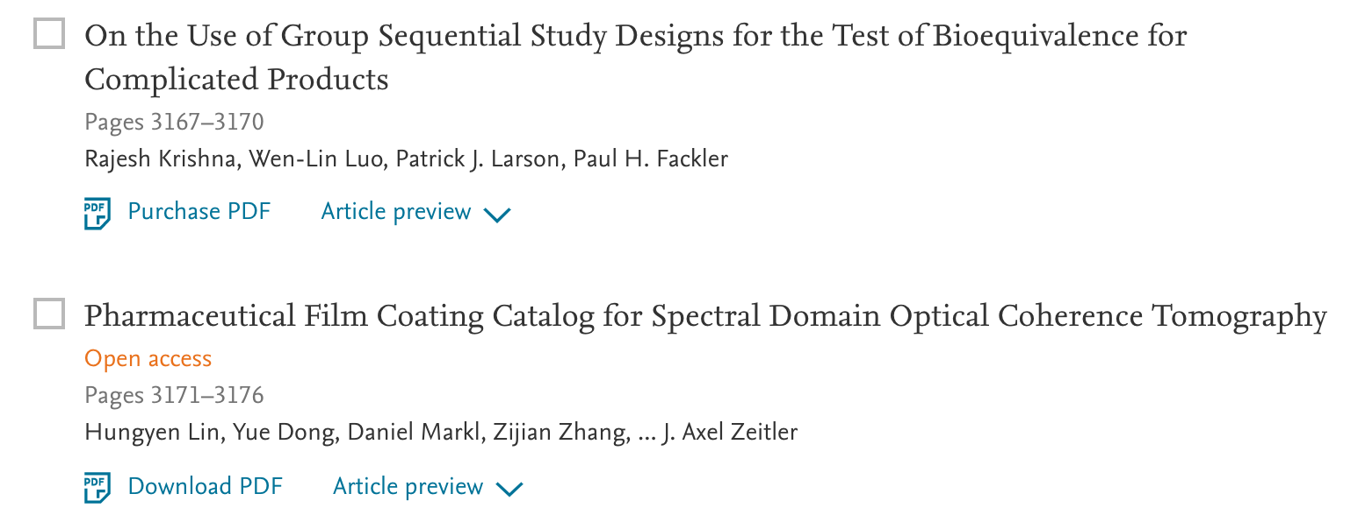

Making it easier to find open access
We are making OA more discoverable.
Currently over 1.3 million articles on ScienceDirect are open access, out of which almost 0.5 million are gold OA.

Slide 11
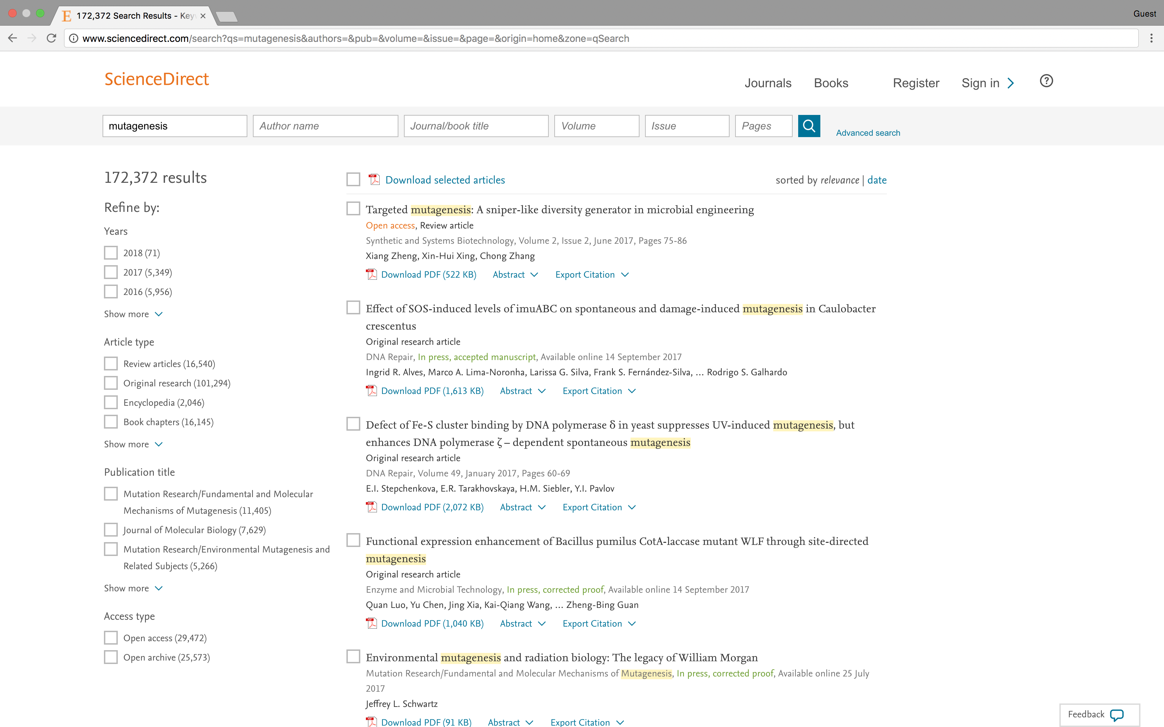
Making it easier to find open access
Open access labelling on article records for additional clarity
Access type search filters*
*Shown to all users
except anonymous guests, because of high bot activity

Slide 12
Green open access

Slide 13

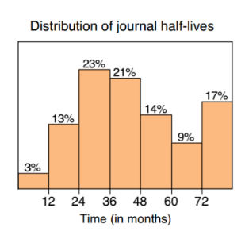
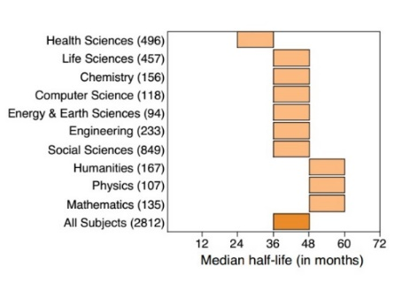
Making green OA a long-term solution
Green OA relies on subscriptions
Subscribers pay to immediately access the final version of an article
Having a time delay – embargo – enables publishers to recoup publishing costs before content becomes available for free
Evidence suggests that subscribers would cancel subscriptions if articles were freely available early enough
Embargo periods are:
Not a new phenomenon
Journal specific – visit elsevier.com/about/open-science/open-access/journal-embargo-finder
Based on the half-life of an article published in the journal
Source: Journal Usage Half-Life, Philip M.Davis,Ph.D. Phil Davis Consulting, pmd8@cornell.edu | http://phil-davis.org. November,25,2013

Slide 14
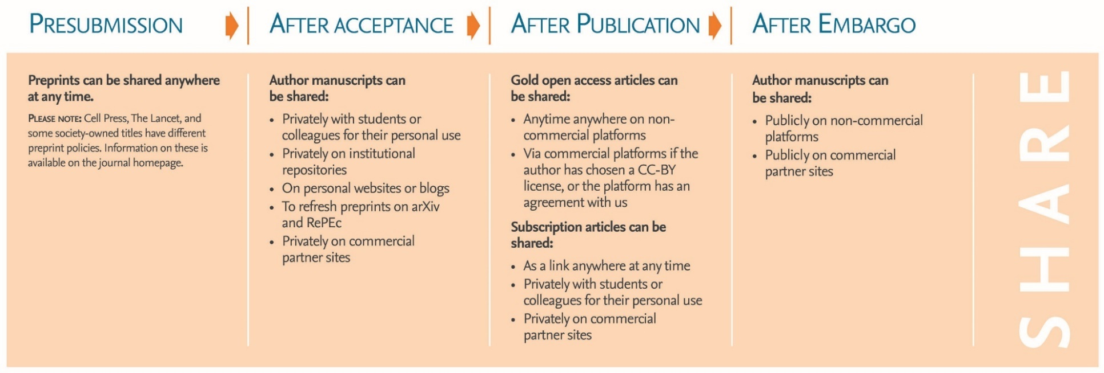
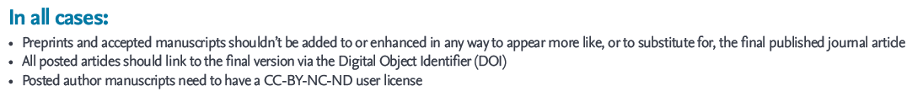
Our sharing guidelines
We support authors to share their work at every stage of the publication process.

Slide 15
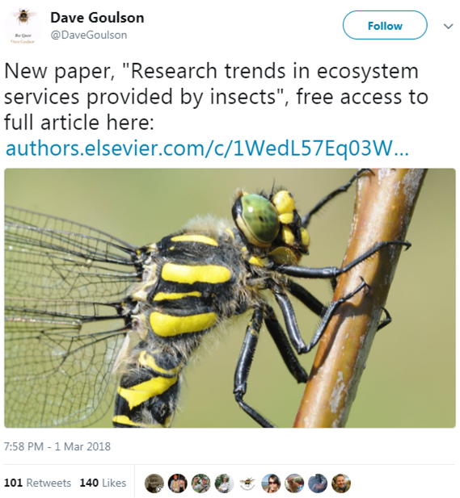
Share Links
The majority of our journals offer Share Links – a customized link which authors receive for their newly-published article on ScienceDirect.
Anyone clicking on the Share Link within a 50-day period will be taken directly to the article with no sign up or registration required.
Enables authors to promote their article and make an impact with their research.

Slide 16
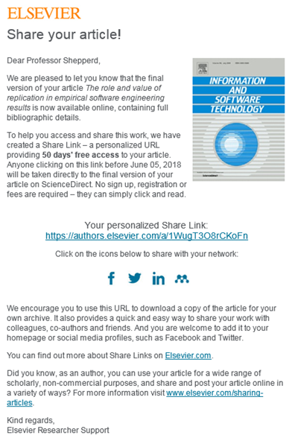
Share Links
By March 2018, Share Links had generated over 10 million article views
Over 1.3 million articles were shared via Share Links
68.7% of links come from social media in 2018
Since Share Links became available to both corresponding and co-authors in August 2017, the number of authors receiving Share Links has increased by over 300%

Slide 17
Institutional repositories
(IRs)

Slide 18

Fueling IRs: free API program
Get metadata & abstracts
Show the final version
Keep users on your IR
Make manuscripts public
Search API can extract the metadata and abstracts of your affiliated authors to help populate your repository, enhance disoverability and create links or embed final version
Entitlements API** can ensure subscribed users see the final version and visitors can see the accepted manuscript hosted on your repository
Article Retrieval API embeds the final article in your repository so subscribers don’t leave your site to access the article
Hosting permissions API can retrieve embargo end dates so you can make manuscripts automatically available to the public after embargo
Did you know?
Scopus customers can also integrate Scopus APIs to retrieve metadata and abstracts across all publishers.
Please Note: **Minimum part of the program.
//dev.elsevier.com/tecdoc_sd_ir_integration.html
Notes:
Elsevier has developed APIs that IR managers can leverage to showcase their institutional output, increase public access and enhance the user experience in three ways:
1) Increase comprehensiveness of coverage of Elsevier-published content by authors from the institution;
2) Help users to access the best available version; and
3) Keep users in the IR, even when reading final articles.

Slide 19
Access to research initiatives

Slide 20



Access initiatives by Elsevier
We provide a range of alternative access options to ensure everyone can access the information they need.
Some of our key programs include:
Research4Life: free or low cost access to books and journals
Free media access through our newsroom
InterLibrary loan
Access to Research
DeepDyve
Emergency Access Initiative
Postdoc access program
Elsevier Resource Centres…and more!

Slide 22
Appendix

Slide 23
Our APCs are below market average…
Market average
Open access journals APC pricing:
Average APC by journals is $1687; for Elsevier it is $1412
Elsevier’s prices range from ~$150 to ~$5000
Hybrid journal APC pricing:
Average APC by journal is $2862; for Elsevier it is lower at $2585.
Elsevier has broader distribution of prices which are tailored to specific communities.
Market average based on data available for top 6 competitors
All average APCs are weighted.
Market average
Market average based on data available for top 6 competitors
All average APCs are weighted.

Slide 24
… yet deliver above average quality
World Base Line
A Hybrid
B Hybrid
C Hybrid
Avg APC List Price 2017 ($)
Hybrid: AVG = $2862
B Gold
Gold: AVG = $1687
A, B, C refers to the 3 top competitors
Bubble size reflect number of titles
Field Weighted Citation Impact (2012-2016)
Market average based on data available for top 6 competitors.
All average APCs are weighted.
Data for C gold unavailable.

Slide 25
Committed to no double dipping
We do not to charge subscribers for open access articles. When calculating subscription prices, we only take into account subscription articles. We do not double dip.
Prices of subscription journals can rise or fall. Elsevier subscription prices depend on the number of subscription articles as well variables such as quality, usage, competitive landscape.
In 2018 we adjusted the subscription list prices of 12 journal titles downwards to reflect falls in subscription article volume
Based on a variety of factors, 102 Elsevier journals had a price change of 0% or lower in 2017. In only 12 of these cases were the price changes related to growth in OA articles at the expense of subscription article volume growth
Notes:
As shown in the previous slides, subscription article volume continues to grow across the industry. However, its also important to note that Elsevier is growing its subscription article volume faster than our major competitors. Our journals therefore look very different to our major competitors, who will need to alter the list price of more of their journals, as OA article volume growth displaces subscription article volume growth.
Furthermore in the balance of the 102 Elsevier journals you can find journals that in previous years had price reductions influenced by Open Access articles and are being monitored regarding multiyear trend in subscription article volume as well as quality to avoid (steep) decreases in 1 year and (steep) increases in the next year and thus keep the journals competitive in price and performance in time.

Slide 26
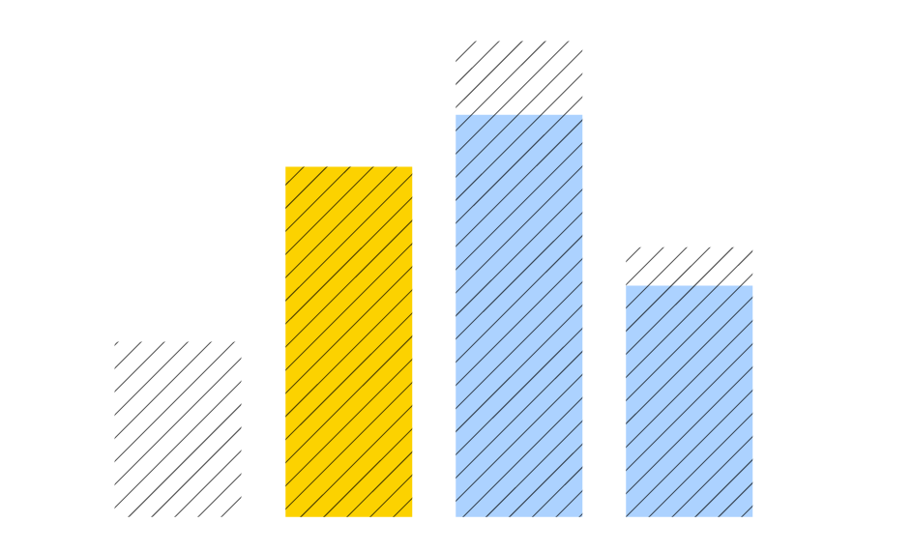
Committed to no double dipping
http://www.elsevier.com/about/company-information/policies/pricing#Dipping
Notes:
As shown in the previous slides, subscription article volume continues to grow across the industry. However, its also important to note that Elsevier is growing its subscription article volume faster than our major competitors. Our journals therefore look very different to our major competitors, who will need to alter the list price of more of their journals, as OA article volume growth displaces subscription article volume growth.
Furthermore in the balance of the 102 Elsevier journals you can find journals that in previous years had price reductions influenced by Open Access articles and are being monitored regarding multiyear trend in subscription article volume as well as quality to avoid (steep) decreases in 1 year and (steep) increases in the next year and thus keep the journals competitive in price and performance in time.

Slide 27
Our embargos strike a balance
They are evidence-based and are reviewed bi-annually
78% of journal embargos are between 12- 24 months
We facilitate funder exceptions by agreement:
    12 month exception for US authors to reflect national dialogue with all stakeholders on open access
    12- 24 month embargo periods for UK researchers to reflect national policy discussions and a gold first approach
Working to provide the infrastructure needed to make it easier for IR’s to provide free access:
    API program with embargo end dates
    Journal embargo finder
    CHORUS

Slide 28
In this section…
Infographic: What do publishers do
Infographic: What we do to increase performance: journals example
Stats: OA can increase the visibility of research but it does not (yet) impact citations
Copyright
Reuse license options for gold OA

Slide 29
OA can increase the visibility of research…
Randomised controlled trial of gold OA vs. subscription-access articles showed increased HTML and PDF downloads and unique visitors in the first 12 months after publication for OA articles.
Source: Davis, P.M. (2010) Does Open Access Lead to Increased Readership and Citations? A Randomized Controlled Trial of Articles Published in APS Journals, Physiologist 53 (6) pp. 197-201k

Slide 30

…but it doesn’t (yet) impact citations
No clear citation advantage for gold open access articles
Studies do show what impacts citations:
  Research quality
  Article type
  Team size
Studies need to :
  Be careful with selection bias
  Control for factors that impact citations
  Be clear on the definition of OA
Join the conversation:
https://www.mendeley.com/groups/5197801/citations-open-access-compared-with-subscription-articles/
Notes:
Given our interest in open access publishing and to ensure we are offering the best support and guidance to our authors, this is an area of research that is of great interest to us. What we have learned from our review to date is that studies looking into this important area should be careful when it comes to selection bias and control for factors such as research quality, article type and team size, as these are essential to giving us a clear and accurate understanding of citation advantage claims. It is essential that open access is defined clearly and accurately, and that other controls are included, such as controlling for citation advantages that may be associated with particular funders or within particular disciplines. Evidence shows that NIH-funded papers, for example, appear far more often than expected in top-cited article populations. The same may be true for other funders and may skew results by showing an OA advantage when really this is a proxy for a particular funder or the quality of the research it typically funds.

Slide 31

Copyright
Describes the rights related to the publication and distribution of research
The publisher’s rights are set out in an agreement between the author and publisher
  In subscription journals, it is common to transfer copyright to the publisher
  In open access, authors generally retain copyright and grant publishers an exclusive license to publish their article
Authors are able to share their articles under both models
Subscription
Authors can:
Share a DOI link to their article on ScienceDirect
Share accepted manuscripts privately within their institutions and publicly after an embargo on certain sites
Use ShareLinks
www.elsevier.com/authors/journal-authors/submit-your-paper/sharing-and-promoting-your-article
Gold OA
Authors can:
Share a DOI link to their article on ScienceDirect
Share their article in the same way that others can – based on the reuse license chosen by the author
Notes:
Copyright is the term used to describe the rights related to the publication and distribution of research. It governs how authors (as well as their employers or funders), publishers and the wider general public can use, publish and distribute articles or books.
Publisher's need publishing rights- and this is determined by a publishing agreement between the author and publisher- usually after acceptance.
In subscription journals it common to transfer the copyright to the publisher. However in open access publishing it is common that the author would retain their copyright.
For subscription articles authors must also include the Creative Commons CC-BY-NC-ND license for author manuscript versions.

Slide 32

We offer a choice of reuse license for gold OA
Tells readers what they can and can’t do with your article
Ensures authors get credit for their work
User license | Authors’ choice | Read, print, download | Redistribute or republish the final article | Translate the article | Download for text and data mining purposes | Reuse portions or extracts from the article in other works | Sell or reuse for commercial purposes
CC BY | 34% | Yes | Yes | Yes | Yes | Yes | Yes
CC BY NC ND | 66% | Yes | Yes | Yes (private use) | Yes | Yes | No
Notes:
The 2nd agreement determines what readers can do with your article. We encourage authors to understand what you are and are not permitting readers to do with your article.
You can see from the chart, that there are two main licenses used in open access publishing one which permits commercial reuse (CC BY) and one which is also liberal but restricts reuse for noncommercial purposes only.
What is important to know is if your funding body or institutional open access policy requires a specific license. This is important as even though you have published your article open access, you still may not comply unless your article in published under the correct license.
Finally, and perhaps most importantly is be informed about your choice. Once your article has been published under a specific user license anyone who downloads or redistributes that article will do so with that particular user license information. This means, you want to change your mind, move from a liberal license such as CC BY to something more restrictive, it will only apply to those readers who download your article with the new license. So you can’t retrospectively go back and change the license on all downloaded copies.

Slide 33
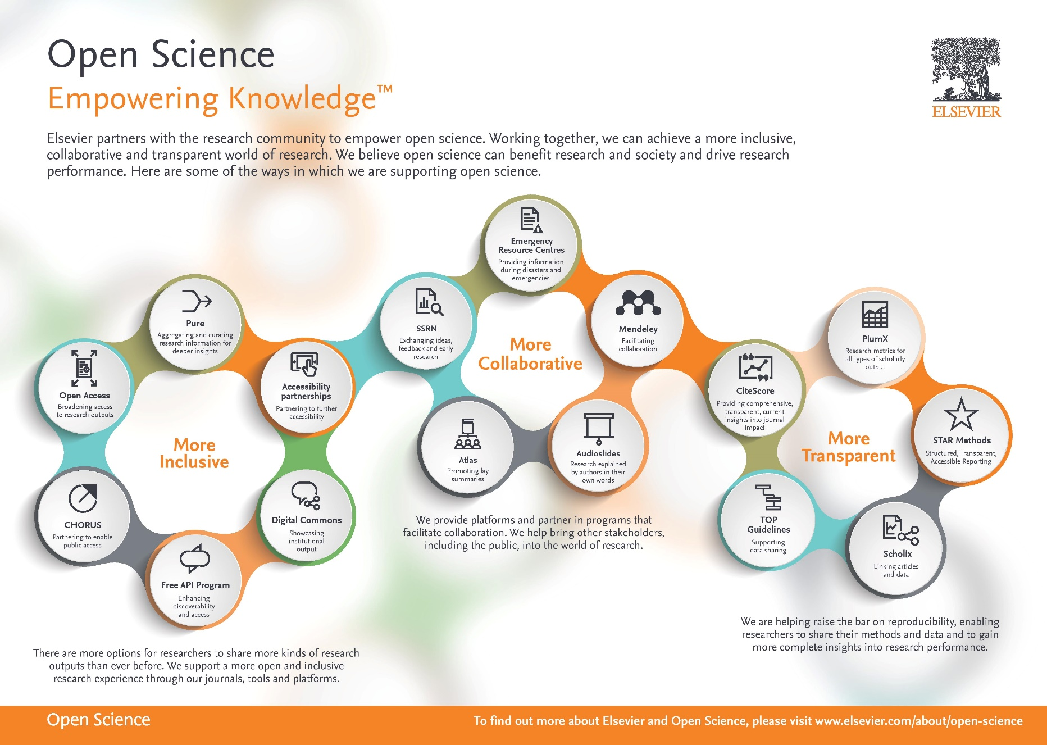

Slide 34
