Slide 1
Sabinet’s role in Open Access
ERIKA JANSE VAN RENSBURG

Slide 2

Notes:
Facilitating access to the world’s information for African organisations and Facilitating access to Africa’s information for the rest of the world for 35 years.

Slide 3

Video to go here

Slide 4

Information Services
Notes:
Information Services consist of:
Legal Information
News Research information
Tenders
Labour
Journals

Slide 5

Sabinet Open Access Content
Free South African National Legislation (small law firms)
Free South African National Legislation (universities)
Sabinet Law
www.journals.co.za open access collection
Online submission platform for publishers
Notes:
Free South African National Legislation (small law firms)
South African National Legislation by means of sponsorship to universities
Sabinet Law
www.journals.co.za open access collection
Online submission platform for publishers

Slide 6
South African National
Legislation (SMME’s)
Access all South African Acts
Law firms that have:
  Three (3) or fewer practicing attorneys
  Fidelity fund certificates and annual law society subscriptions up to date
  Internet connectivity for use of this online legislation product
Notes:
Sabinet offers small, qualifying law firms access to this service for an undetermined period.
The law firm gets free access to an alphabetical list of Acts where they can access and view all South African Acts (users will have to be logged on to view the list)
To qualify for this free service and benefits, the law firm must:
Comprise of three (3) or fewer practicing attorneys
Their fidelity fund certificates and annual law society subscriptions must be up to date and paid in full
The law firm must already have internet connectivity to be able to make use of this online legislation product

Slide 7
South African National
Legislation (Law Faculties)
Free Access to:
  Public universities
  Universities that have a practicing law faculty

Slide 8
SabinetLaw
All government, parliamentary and legislative information in the Legislative Profile
We provide free access to:
  Articles written by our experts on various pieces of upcoming and current legislation
  The entire legislative profile from when it becomes a Draft Bill to becoming an Act
  Monitoring of the media in relation to a specific Draft Bill, Bill and Act with links added to for ease of use
Notes:
SabinetLaw brings together government, parliamentary and legislative information in a way to answer all questions on the background, and legislation process leading up to the adoption of a piece of legislation.
We provide free access to the following:
Articles written by our experts on various pieces of upcoming and current legislation;
The entire legislative profile from when it becomes a Draft Bill to becoming an Act;
Monitoring of the media in relation to a specific Draft Bill, Bill and Act with links added to for ease of use;

Slide 9


African Journals
Notes:
Launched in 2001 with 4 South African journals
Largest and most comprehensive, searchable collection of full-text African electronic journals available on one platform.
More discoverable through 3rd party harvesting and partnerships

Slide 10
African Journals
The most comprehensive, searchable collection of full-text electronic Southern African journals
To date there are more than 560 full-text journals available, complemented by abstracts
Assisting the publishing value chain by helping publishers to be sustainable in the current South African economic climate

Slide 11
Open Access Journals (OA)
101 journals listed in OA journal collection
180 OA journals listed in African Journal Archive
Visit www.journal.co.za

Slide 12
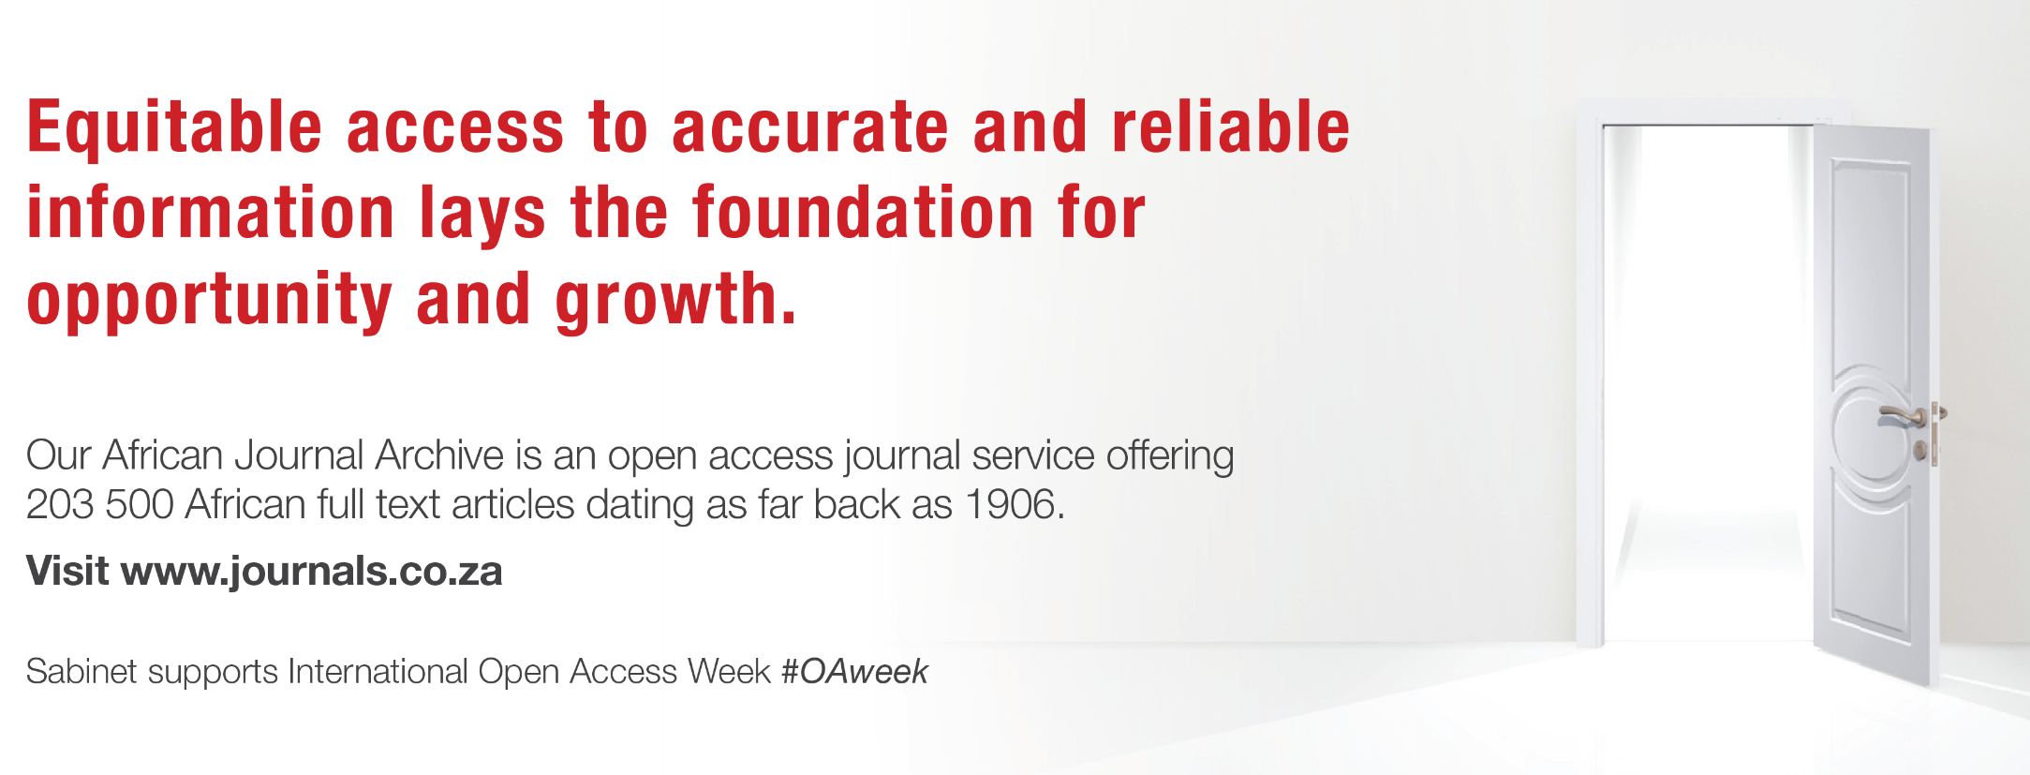
African Journals

Slide 13
Sabinet’s OA Statement
Sabinet recognises and supports the importance of Open Access to research whilst acknowledging that not all publishers are in a position to make their publications available as Open Access.
Notes:
Sabinet offers support to OA publishers
Credible journals are allowed to join www.journals.co.za at a small annual fee
Sabinet subsidises a portion of the annual fee
The fee includes: hosting, indexing and administration of the journal on www.journals.co.za

Slide 14
Benefits for OA publishers on www.journals.co.za
Support and updating of journal content
Increased discoverability
Partnering with with Google Scholar, OCLC, Ex Libris, Ebsco, Yewno
Detailed usage statistical reports
Forms part of the most comprehensive collection of African journals available in the world
Platform with enhanced user experience continuous improvements
Notes:
Support and updating of journal content
Increased discoverability through:
Local and international marketing initiatives
Initiatives and agreements that Sabinet has with Google Scholar, OCLC, Ex Libris, Ebsco, Yewno, etc.
The www.journals.co.za platform is maintained and enhancements are performed regularly.
Access to detailed usage statistical reports.
Titles form part of the most comprehensive collection of African journals available in the world.
Sabinet consults with its advisory board on a frequent basis to ensure that the user experience on the platform is well looked after and that clients are satisfied with the ease of use of the platform.
Sabinet will soon launch an online publishing system for Publishers which will also include an Article Processing Charge workflow for Open Access Publishers.

Slide 15
Benefits for OA publishers on www.journals.co.za (cont.)
COMING SOON:
Online publishing system for Publishers which will also include an Article Processing Charge workflow for Open Access Publishers.

Slide 16
Predatory Journals

Slide 17
Predatory Journals
Open Access journals that exist for the sole purpose of proﬁt
Generating proﬁts by charging (excessive) author fees, also known as article processing charges (APCs).
Solicit manuscripts by spamming researchers (especially Yahoo and Gmail accounts)
Prof Mouton, June 2018
Notes:
A (somewhat implicit) focus of this study would be to address issues around quality and ethics of scholarly publishing in SA rather than merely of volume and output.
One of the (unintended) outcomes of the study was our discovery that predatory (and other forms of unethical practices in SA scholarly publishing ) have become quite pervasive.

Slide 18
Scholarly Publishing
Landscape of South Africa
Centre for Research on Evaluation, Science and Technology (CREST) – March 2015
Comprehensive analysis of the state of journal and book publishing in South Africa
To investigate how the revision in the funding framework of 2005 had impacted on journal, book and conference proceeding outputs in the country.
Prof Mouton, June 2018
Notes:
Setting the scene
Publisher session: Prof Johann Mouton, Crest, University of Stellenbosch
CREST was commissioned in March 2015 to undertake a comprehensive analysis of the state of journal and book publishing in South Africa. This commission was issued specifically to investigate how the revision in the funding framework of 2005 had impacted on journal, book and conference proceeding outputs in the country.
A (somewhat implicit) focus of this study would be to address issues around quality and ethics of scholarly publishing in SA rather than merely of volume and output.
One of the (unintended) outcomes of the study was our discovery that predatory (and other forms of unethical practices in SA scholarly publishing ) have become quite pervasive.

Slide 19
Focus and Outcomes
A (somewhat implicit) focus of this study - address issues around quality and ethics of scholarly publishing in SA rather than merely of volume and output.
One of the (unintended) outcomes of the study was the discovery that predatory (and other forms of unethical practices in SA scholarly publishing ) have become quite pervasive
Prof Mouton, June 2018
Notes:
A (somewhat implicit) focus of this study would be to address issues around quality and ethics of scholarly publishing in SA rather than merely of volume and output.
One of the (unintended) outcomes of the study was our discovery that predatory (and other forms of unethical practices in SA scholarly publishing ) have become quite pervasive.

Slide 20
New websites/tools to identify predatory journals
Stop predatory (https://predatoryjournals.com/)
Cabell (https://cabells.com/about-blacklist)
Predator vs Academator: https://predatorvsacademator.wordpress.com/2017/01/18/alleged-misleading-metrics/
Consult the Directory of Open Access Journals (https://doaj.org/)
New websites that list “fake” journals: (https://fakejournalss.wordpress.com/list-of-fake-computer-science-journals/)
Prof Mouton, June 2018

Slide 21
The extent of unethical practices
Increasingly unethical and fraudulent behaviour in science
Increases in plagiarism (correlates in retractions), different forms of misconduct (ghost authorship, fake peer review, unethical reporting of scientific results) etc.
Notes:
Predatory publishing is only one of the manifestations of increasingly unethical and fraudulent behaviour in science
There is growing evidence of increases in plagiarism (correlates in retractions), different forms of misconduct (ghost authorship, fake peer review, unethical reporting of scientific results) etc.

Slide 22
Unethical examples
Edwards and Roy (2017: Academic Research in the 21st Century: Maintaining Scientiﬁc Integrity in a Climate of Perverse Incentives and Hyper competition)
Prof Mouton, June 2018

Slide 23
Unethical examples (cont.)
Invitation as speaker to bogus conferences
Special offer on papers
Prof Mouton, June 2018

Slide 24
Predatory publishing and
Sabinet
Procedures in place to combat predatory journals
Evaluates every new journal
Annual Publishers Sessions to educate publishers of changes/risks in the industry

Slide 25
New Initiatives:
Online Publishing Platform
Online peer review, production and APC management system
Fostering sustainable business models for OA publishers
Sabinet’s experience and perspective is that there is not enough support in the system to be fully OA
Notes:
Providing all interested publishers with an online peer review, production and APC management system
Want to help with the fostering of a sustainable business models for OA publishers
Sabinet experience and perspective is that there is not enough support in the system to be fully OA
Some societies do not allow publishers to charge OA fees

Slide 26
New Initiatives:
Online Publishing System (cont.)
  Local option that is not open software
  Local support
  Cost effective solution
  Sustainable model
  Must serve open access and subscription content
  Identified 4 potential solutions
  session with some publishers to evaluate the system investigated
  Business case and model looks favourable for publishers
    Peer review workflow
    Publishing/layout module
    Article Processing Charges workflow
Need Expressed
Investigation
Timeline
2-3 months for implementation
Signing of agreement end September
Notes:
Can provide cost estimations
Timeline – would like to have it implemented in the next 6 months
APC are essential to be comp
Need expressed
A local option that is not open software
Local support
Cost effective solution
Sustainable model
Must serve open access and subscription content
Investigation done
Identified 4 potential solutions
Had a session with some publishers to evaluate the system investigated
Business case and model looks favourable for publishers
Peer review workflow
Publishing/layout module
Article Processing Charges workflow
Signing of agreement
Timeline

Slide 27
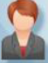
Author
submits
EXAMPLE
Confirmation
Editorial & Peer Review
Acceptance
Payment complete & continue
API Notifies APC Management system
with metadata
API notifies system
APC author confirmation page with terms in payment system
“Payment due”
API notification
SUBMIT
Payment system
completes
transaction
Potential notification
to funders, libraries,
institutions

Slide 28

Training and Support
Complimentary training on all our services.

Slide 29

Contact Us
info@sabinet.co.za
0800 11 85 95

