Slide 1
More than just
a book…

Slide 3
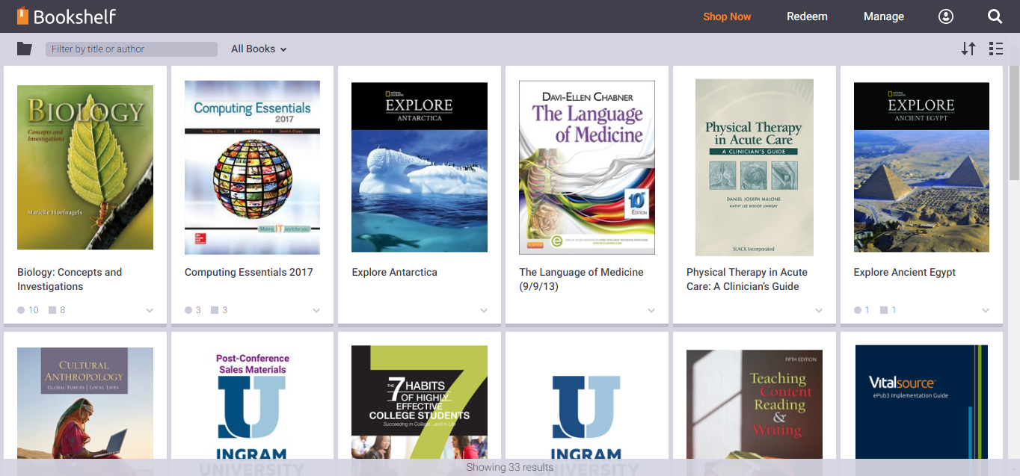
Notes:
Bookshelf Library

Slide 4
Notes:
After I click on the book title to launch it, I have opened the Table of Contents so that you can see how easy it is to navigate to a particular chapter. You could also, at this point, explain the tools in the left nav as well as the tools along the bottom. (I will show Notes/Highlights in another screen)

Slide 5
Notes:
I opened the Notebook (icon) to show Notes and Highlights, as well as the link out to the Launch Review Mode. You could also mention the PRINT and EXPORT TO ONENOTE icons at the top. We have added the OneNote integration to allow students to collect their notes and highlights in a system where they often take other notes.

Slide 6
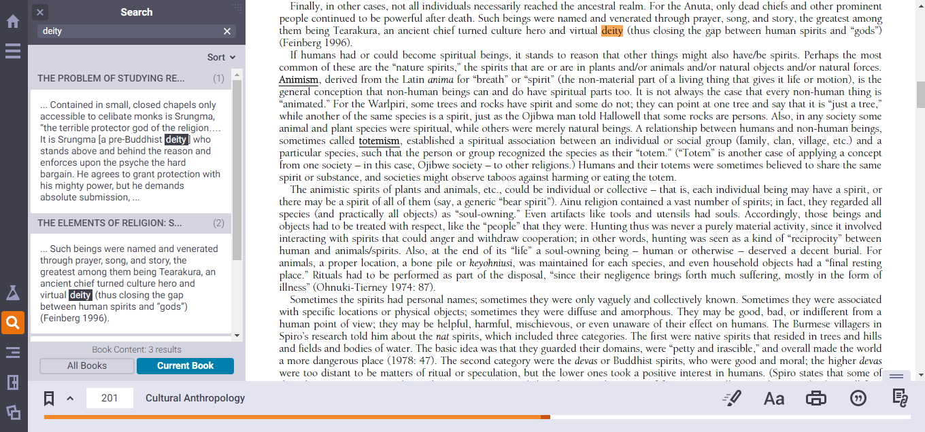
Notes:
This is highlighting the SEARCH functionality. I jumped to one of the pages where the “keyword” appeared. This search was done in the CURRENT book, but we also could have searched across all titles in our library. I’d use this last screen shot to also talk about simple navigation.

Slide 7
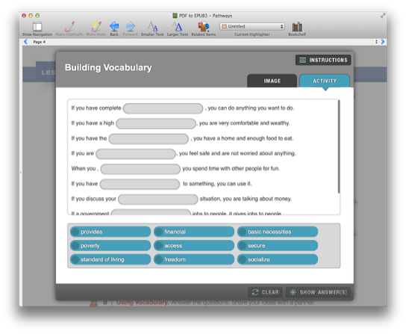
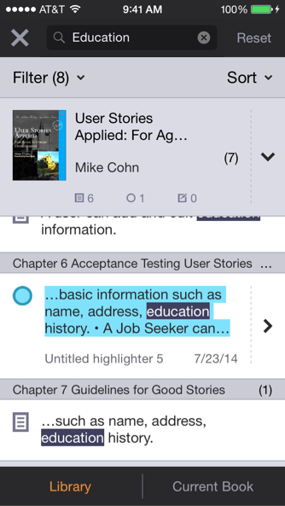
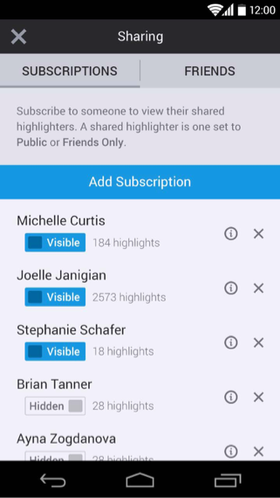
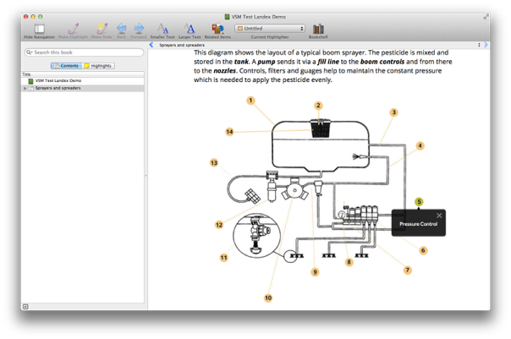
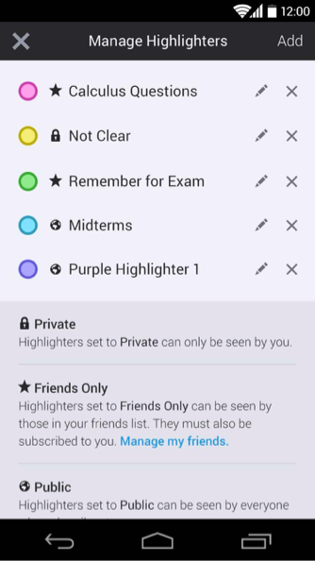
More than just a book!
EPUB 3 support allows for rich media, interactivity and outcomes reporting
Robust search across the entire library
Share notes and highlights with a study group…
Integrations with third-party eResources
Create notes / highlights that sync across the platform
…or academics can share with their students

Slide 8
Every release and version provides:
Accessibility Support
At need users have the support they require… and want!
Localisation
User Interface is in your language of choice, or need!
Synchronisation
Personalized data is always available, without thinking about it!
Cloud based account
Your account is in the cloud, so your content is always there!

Slide 9
More than just a book!
Available where, and when you need it!
Online support
It works from the cloud in any modern browser, even mobile devices!
Offline support
Download content, and use it offline…and automatically sync back up!
Customisation options are available
Online
White labeled options
Embedded into customer portal
Create from scratch with API’s
Offline
Custom Branded Applications in the AppStores
Create from scratch with API’s
(fall 2016)

Slide 10
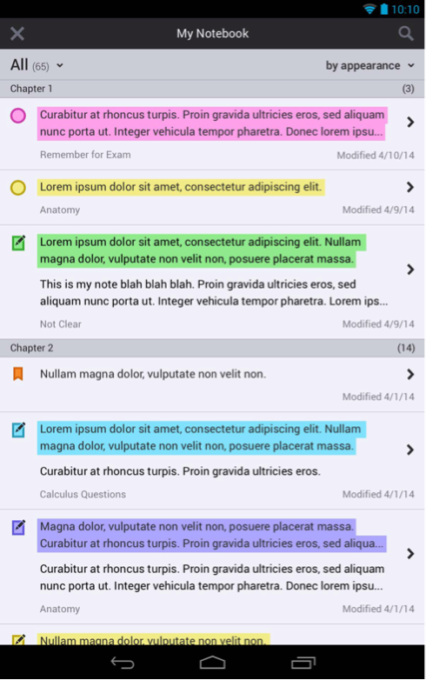
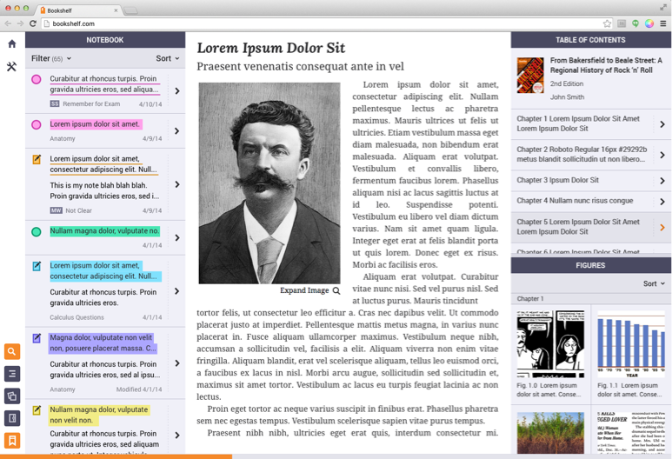
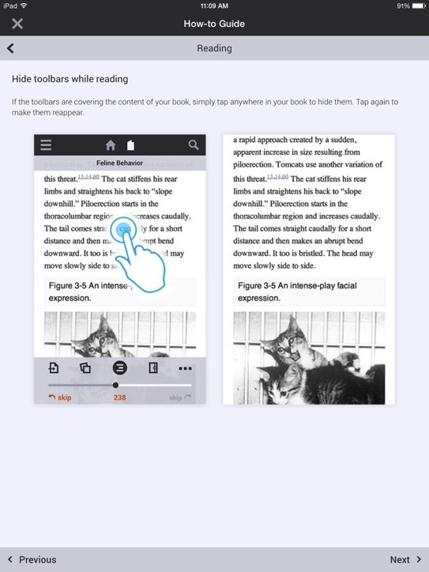
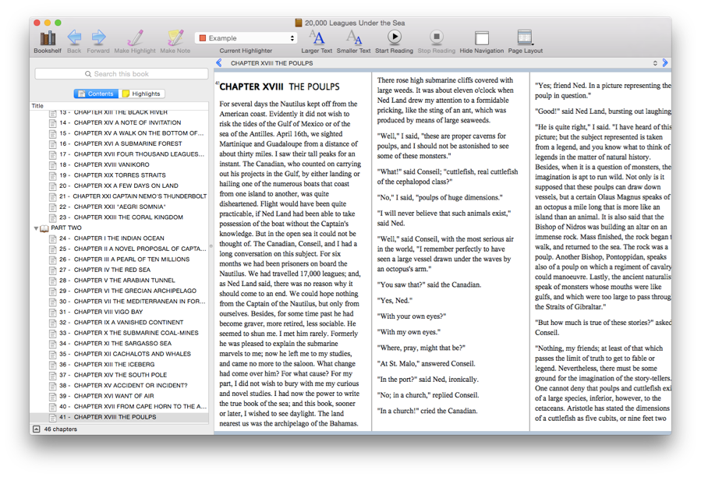
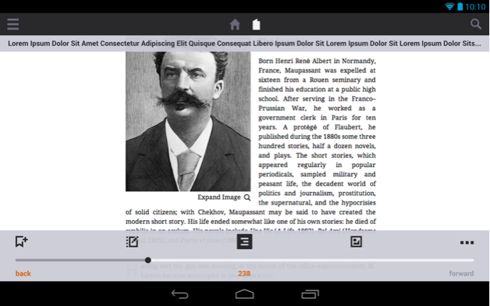
Fully-featured reading apps for Mac, Windows, iOS, Android, Chromebook and the browser.

Slide 11
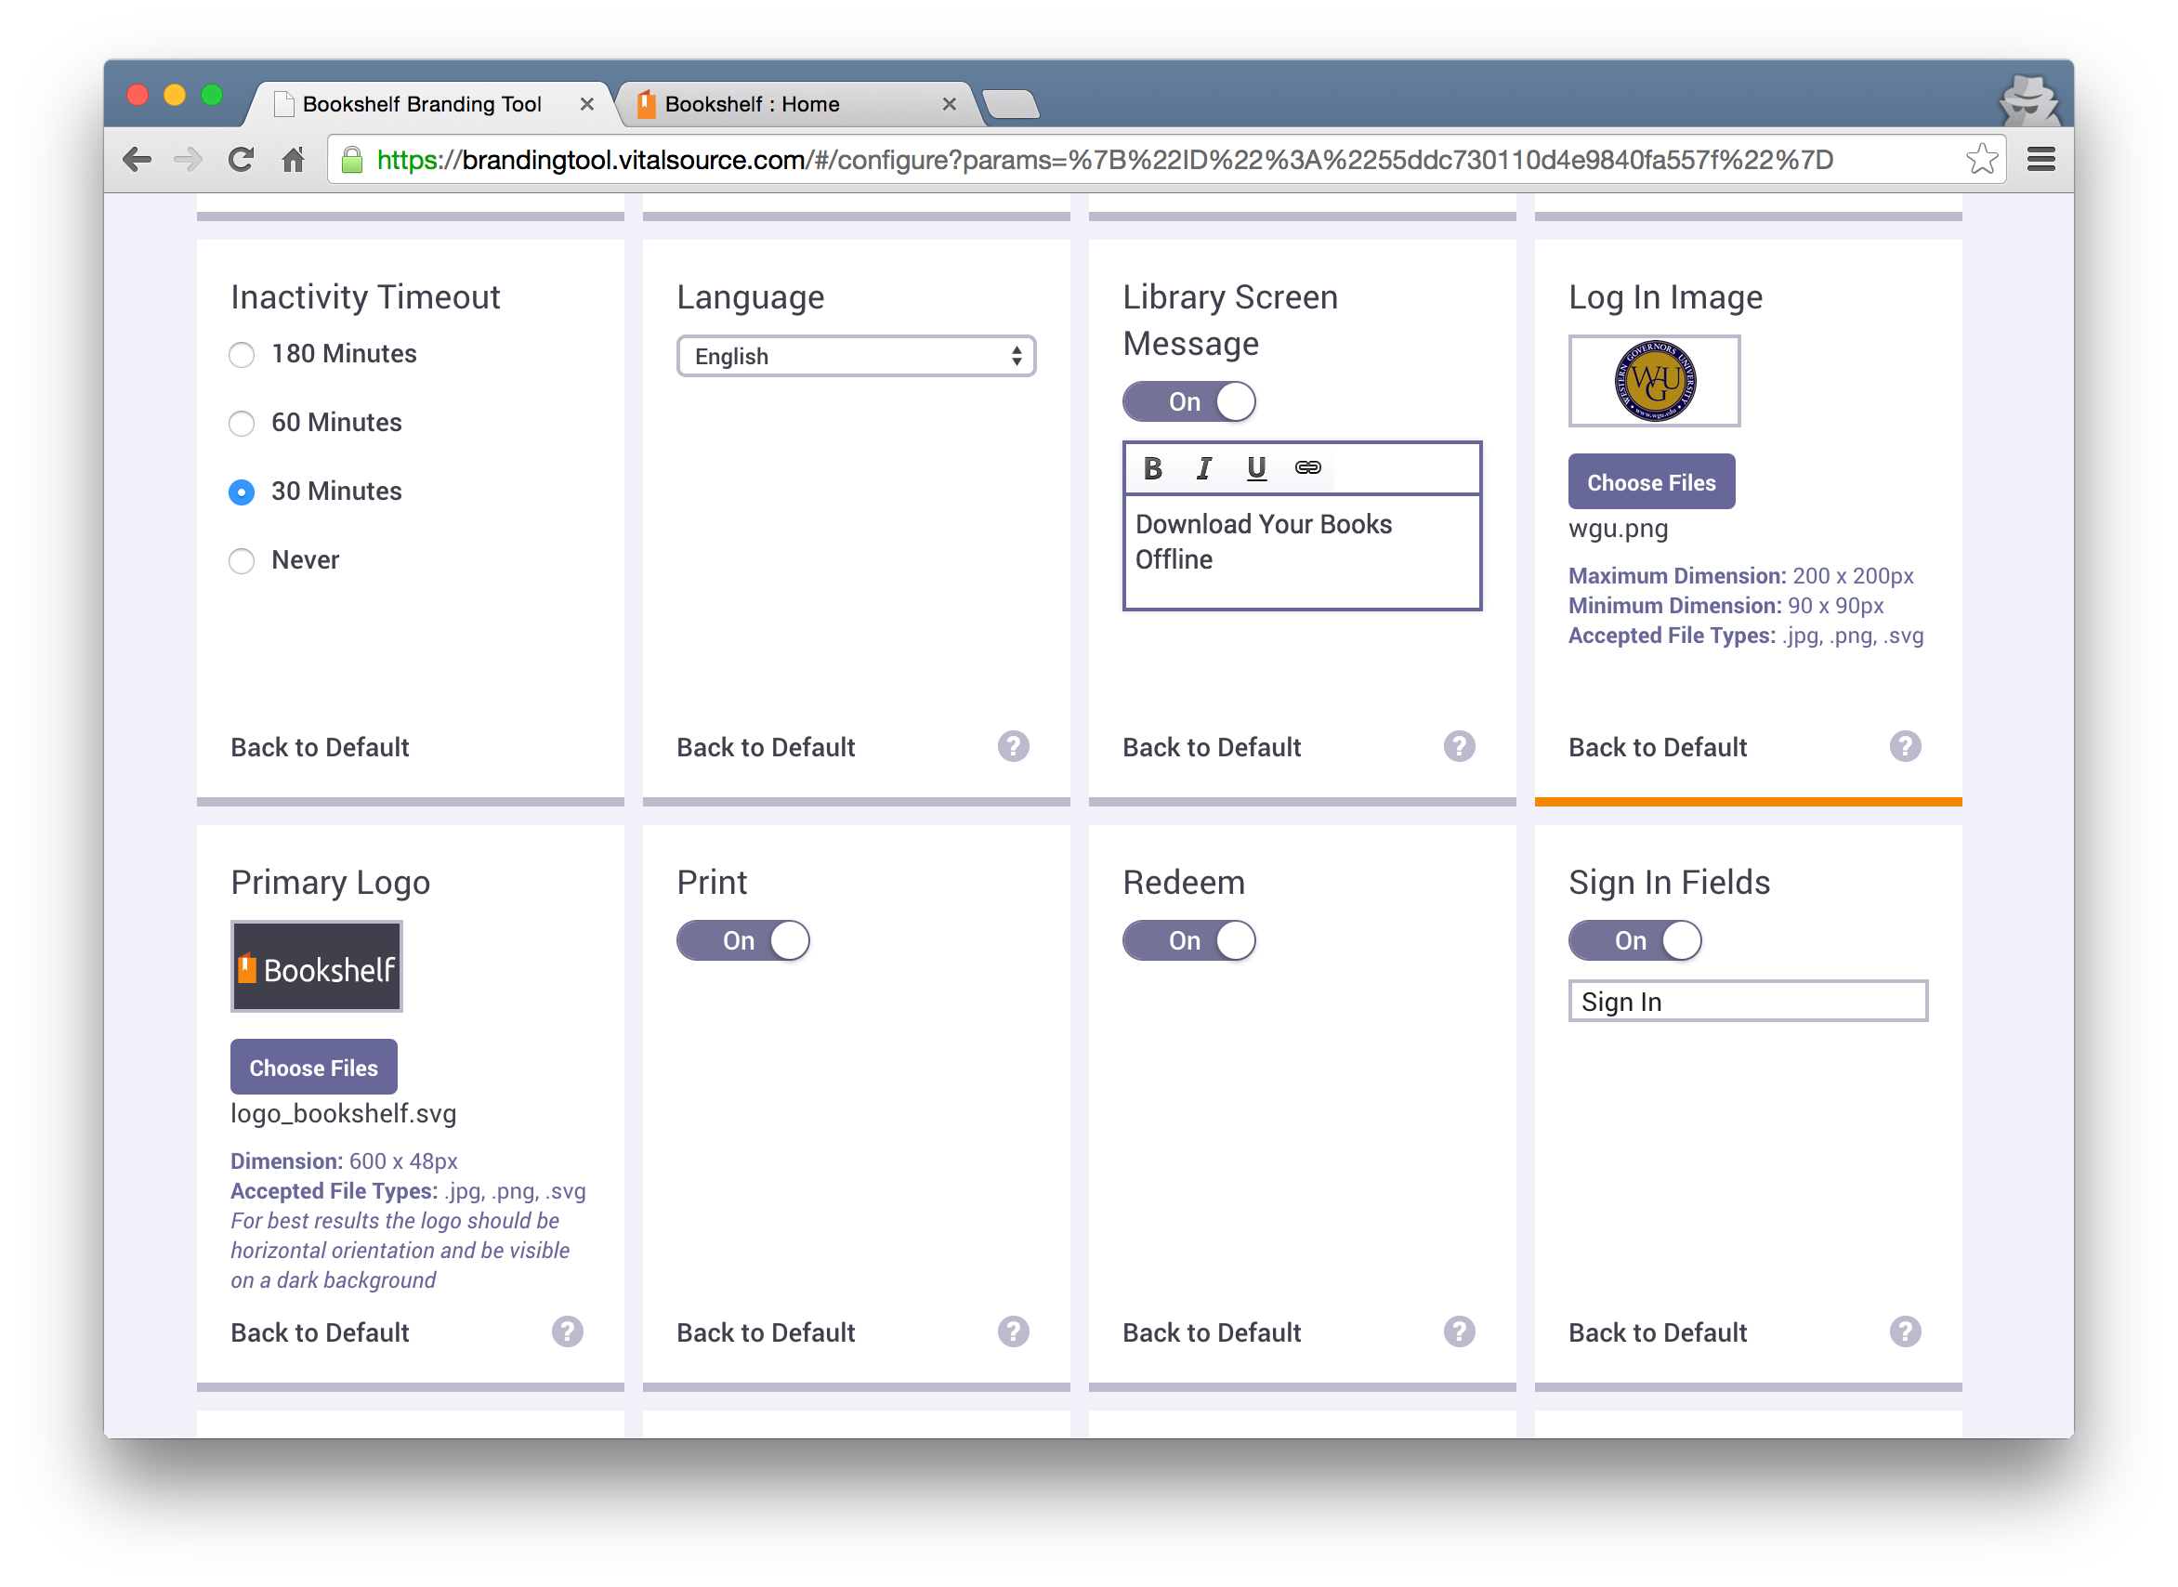
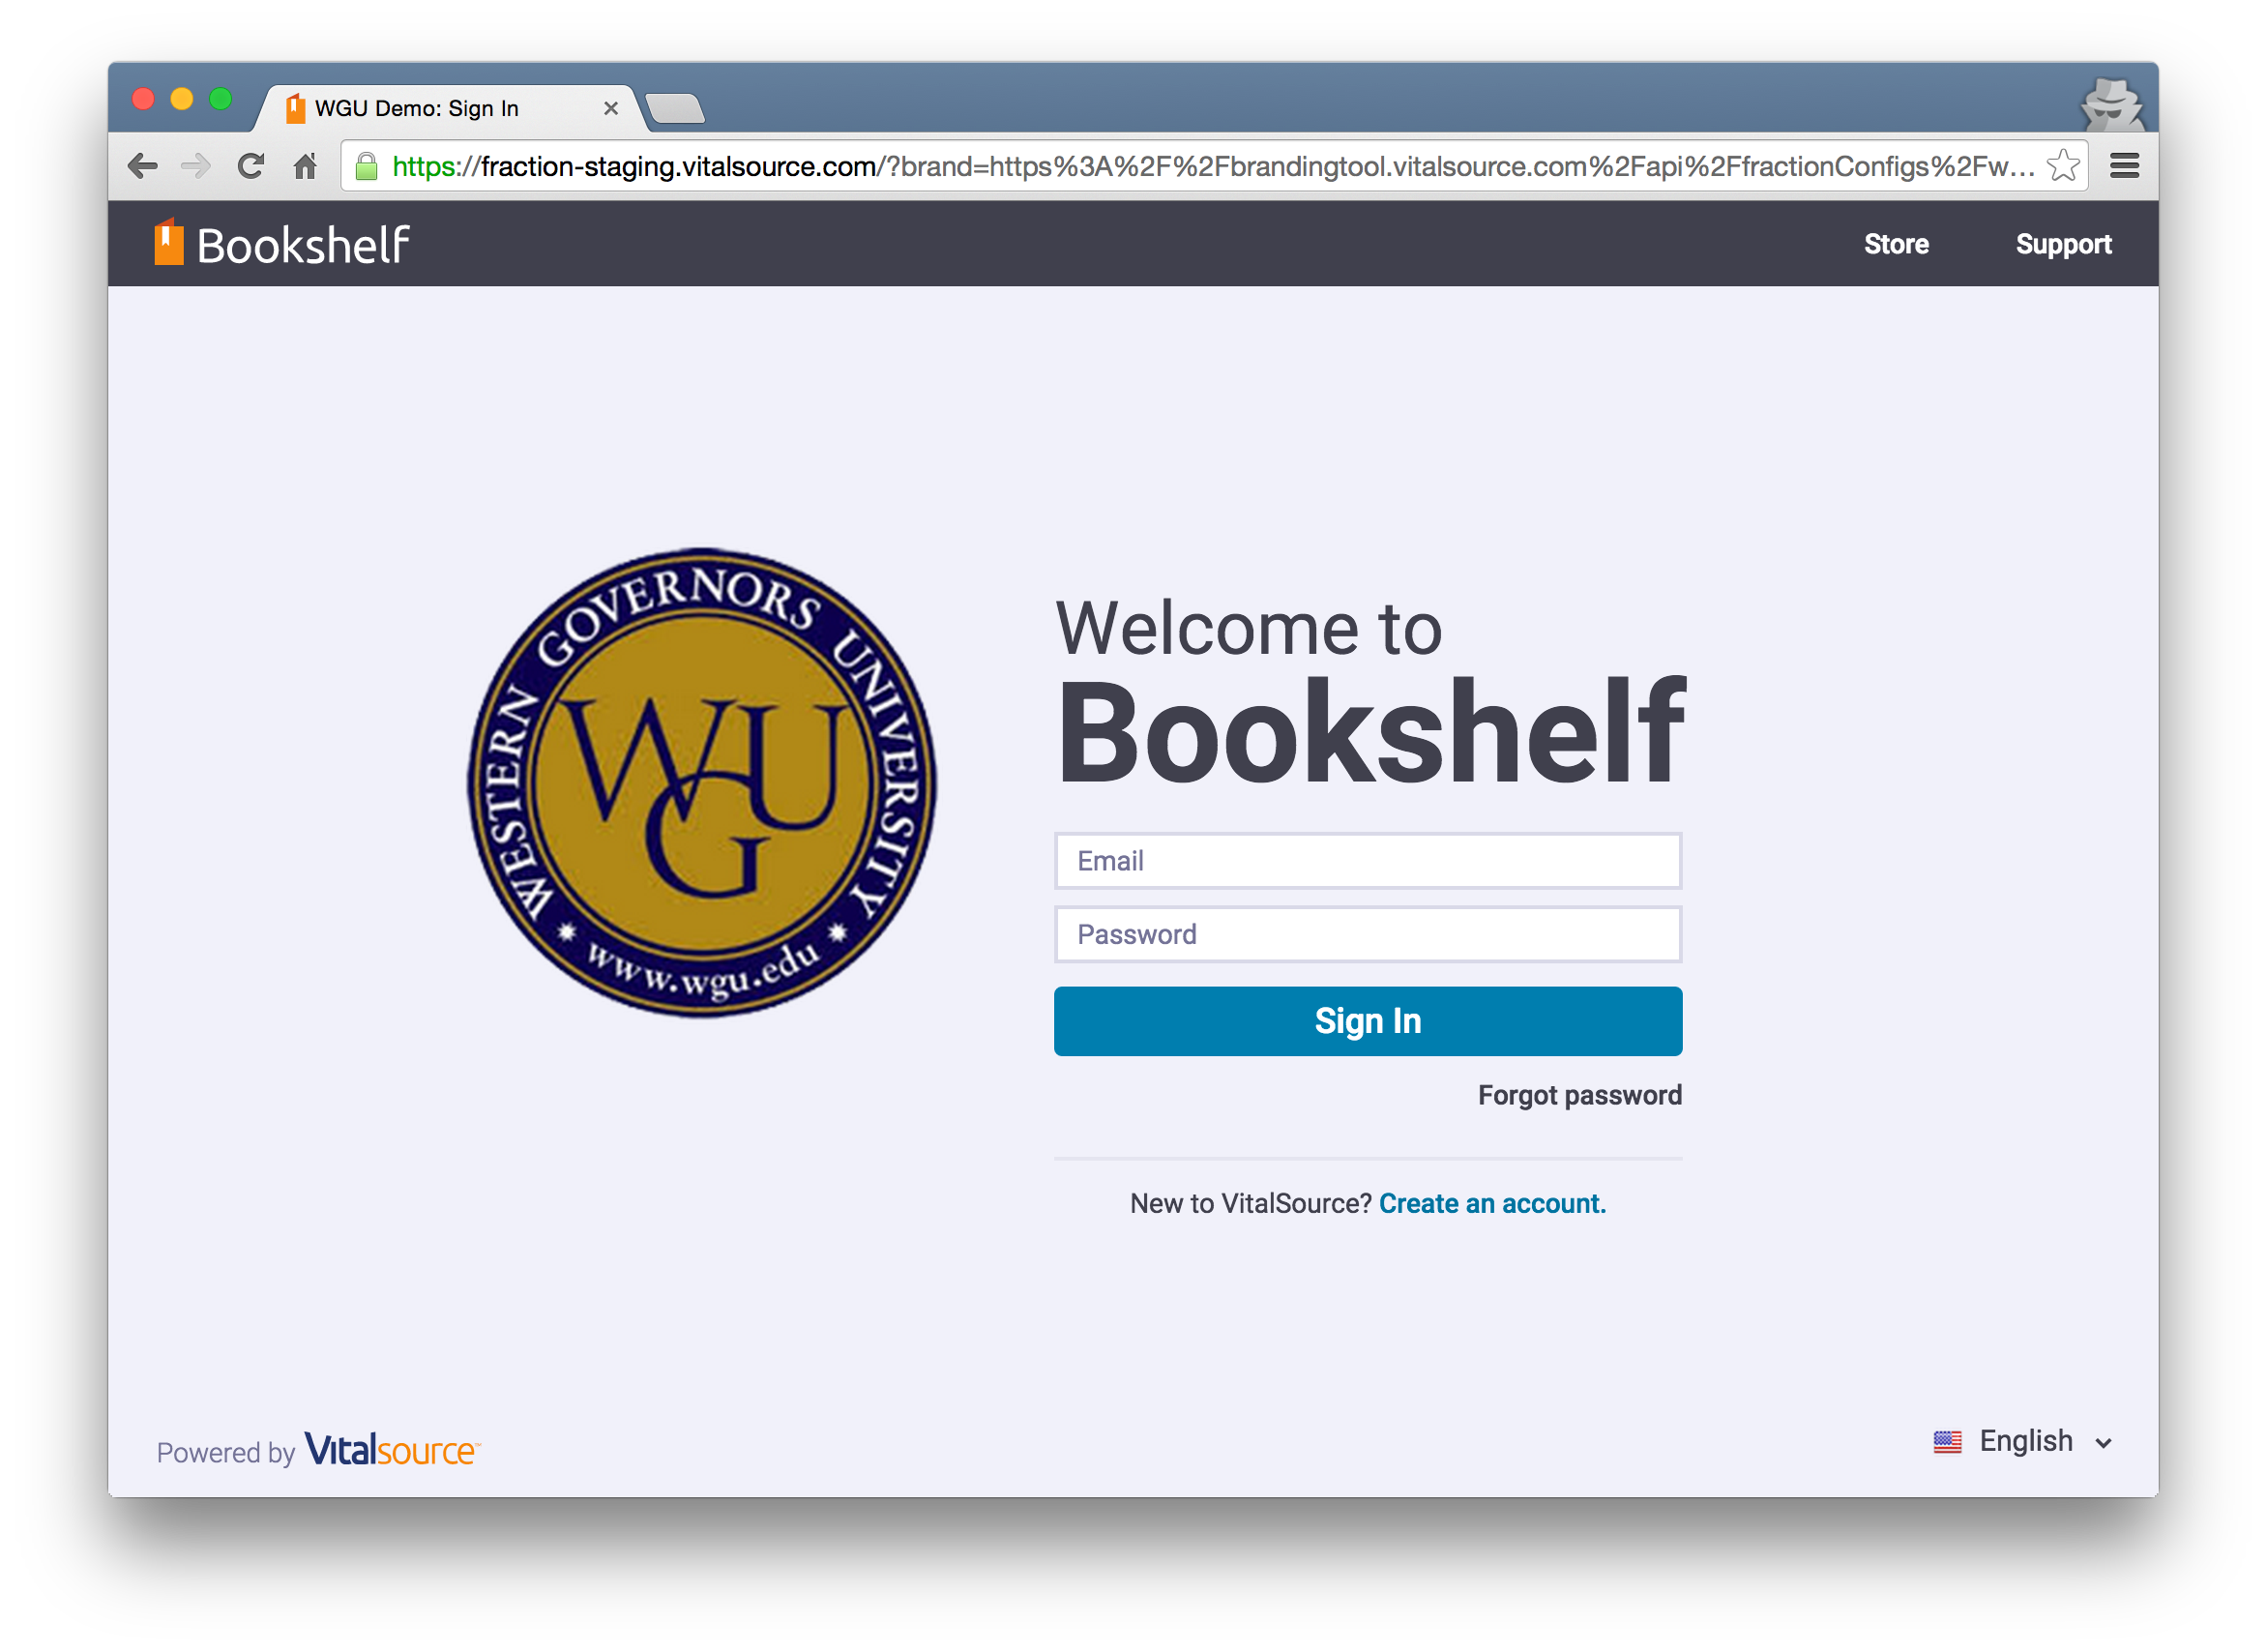
Branding and Embedding

Slide 12
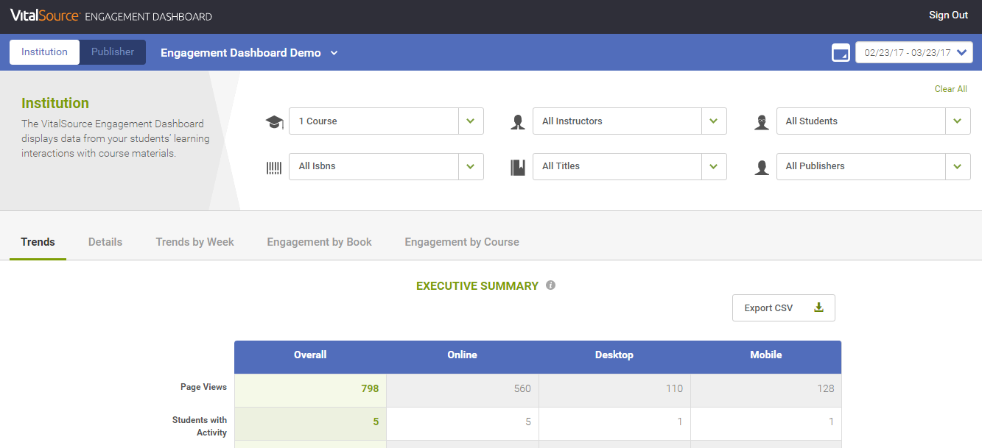
Analytics- data that can tell a story
Engagement Dashboard
Data Feeds
Rollups by student, book, course and university
Smart filters to pinpoint specific datasets
Fast data exports
Leverages the IMS Caliper standard
Near real-time data stream
Our most granular data

Slide 13
Key New Features
Text-to-Speech/Read Aloud in mobile apps
Export to OneNote
Review Mode
New Labs area allows us to provide “in product” feedback about new features we are contemplating adding to the platform
Working to streamline the mobile and desktop apps
MLA, APA, and Harvard citation links
Assumes that the content provider gave them to us
Assigned Readings
Can set assign chunks of content with specific start and end-points to optimize time spent learning

Slide 14
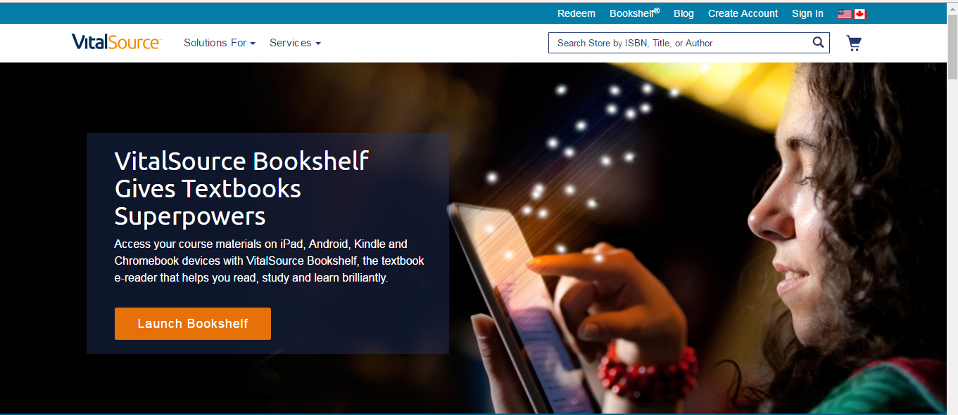
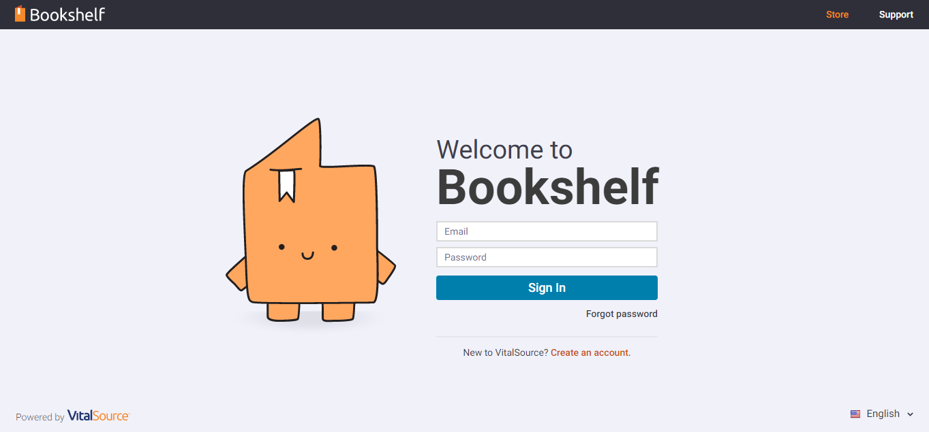
For more information…
About Bookshelf
www.vitalsource.com/bookshelf-features
To start reading in Bookshelf
www.Bookshelf.vitalsource.com

