Slide 1
Beyond OA: Additional methods for enhanced exposure NMU Open Access Seminar 30 October 2018 NMU Port Elizabeth
Wynand van der Walt
Head Librarian: Technical Services
Rhodes University

Slide 2
Content
Linked Data Records
MODS Linked Data records
Wikipedia & Blogs
Tips and Tools
Rhodes University/ Department / Unit / Document / Date

Slide 3
Semantic Web
Vision:
To provide information in a machine-interpretable format
In order to enable intelligent agents to act on our behalf through interpretation of the relationships between objects

Slide 4
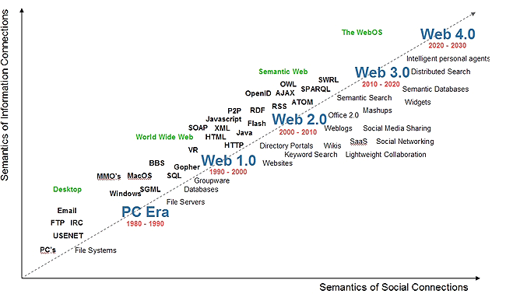
The semantic web

Slide 5
Reflect
Linked Data in Context of Knowledge Engineering in relation to the Semantic Web
Data Collation
Data Visibility
Data Accessibility (Expression)
Data Diffusion
Data Integration
Data Interoperability
Data Use/Re-use

Slide 6
Linked Data
Linked Data Records are:
‘Set of best practices for the publication of data on the web’ (Van Hooland & Verborgh 2014)
Certain relationships are established and expressed through identifiers
Aim to link all metadata fields in a meaningful manner

Slide 7
MODS Linked Data Records
Fields in MODS Data Linked Records:
Creator
Creator type
Role Term
Contribution type
Genre
Language
Subject

Slide 8
MODS Linked Data Records
Creator
Authority – ORCiD if not Library of Congress Name Authority File (LCNAF)

Slide 9
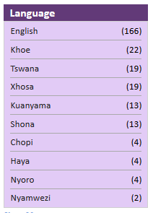
MODS Linked Data Records
Language
Authority – ISO 639 Series

Slide 10
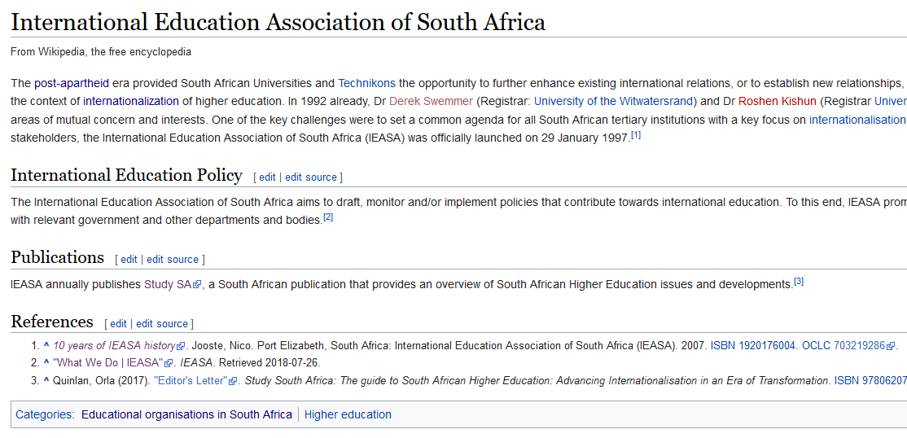
Wikipedia & Blogs

Slide 11
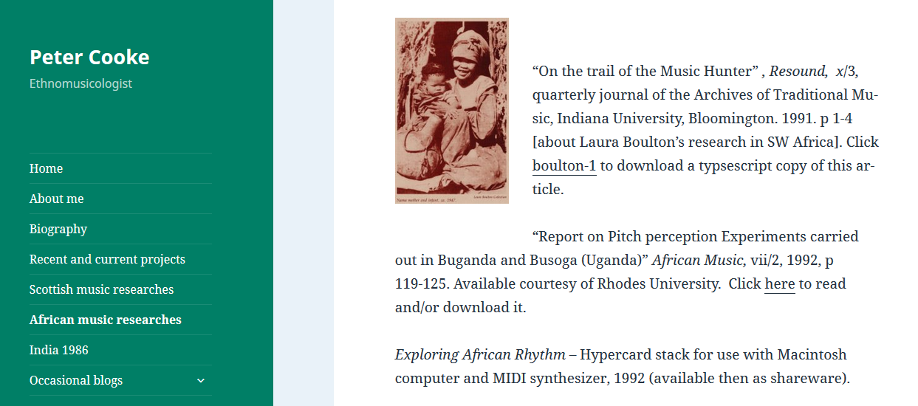
Wikipedia & Blogs

Slide 12
Key role changes?
Subject specialists
Metadata specialists
Repository managers
Systems Librarians
Editors
Authors
Publishers
Etc.
Knowledge Engineers

Slide 13
Thank you!
Wynand van der Walt
w.vanderwalt@ru.ac.za

