Slide 2
Publishing in Open Access Journals Increasing Institutional Research Impact
Pierre de Villiers
Managing Director
AOSIS

Slide 3
Outline
Background
What is an open access journal?
What is the status of open access in RSA?
What is meant by research impact?
How is research impact measured?
Why is measuring research impact important – the SA perspective
Open Access and impact on research

Slide 4
AOSIS (est. 1999)
PUBLISHING
eLearning
eCPD

Slide 5
Open Access Journals
28

Slide 6
AOSIS – article growth

Slide 7
AOSIS Journals -business models

Slide 8
OA Scholarly Books
Humanities
Social Sciences
Peer review
Open Access
APC funding

Slide 9
Open Access Journal
Online journal
Free to use to the reader
Restrictions in use (user license) – “Gratis” vs “Libre”
NOT free to produce

Slide 10
DOAJ.org – RSA 2014
Lars Bjørnshauge, DOAJ, 2014

Slide 11
SA Journals 2014 Tipping the scale to OA!
De Villiers, 2014: http://oaspa.org/conference/presentations-coasp-2014/

Slide 12
RSA situation - 2015
DHET “accredited” = 302
Open Access = 48% (146)
WoS (ISI) = 22% (65)
IBSS = 14% (41)
Scopus = 38% (115)
ASSAf Newsletter, July 2015

Slide 13
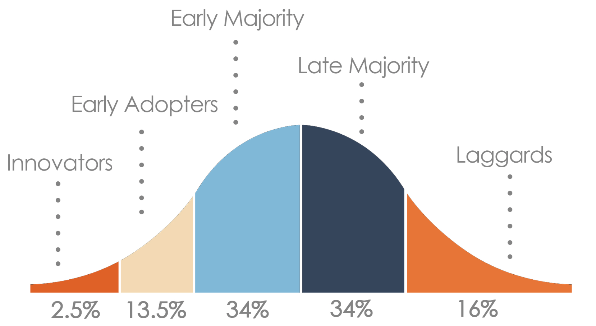
OA in RSA entering “Late Majority” phase
Everett Rogers, Diffusion of Innovations

Slide 14
Research Impact
'the demonstrable contribution that excellent research makes to society and the economy'
Research Councils UK (RCUK)

Slide 15
What is meant by research impact?
Acid test
taken up and used by policymakers and practitioners
led to improvements in services and/or business
Research Councils, UK

Slide 16
But……..in reality
Number of publications
Journal articles
Research reports
Research books
Conference presentations
Numbers!

Slide 17
RSA subsidy system
“When the ..DHET replaced the ‘SAPSE-110’ higher
education funding system with the ‘New Funding Formula’ (NFF) in 2004, it is unlikely that they imagined it would give rise to an entire new industry within university administrations: the management of journal and book publication outputs by academic committees and by research support departments”
Butler-Adam J. An investment in knowledge….producing new interest. S Afr J Sci. 2015;111(7/8)
Embargo: Courtesy S Afr J Sci

Slide 18
Research output at HEI’s (RSA)
Sheppard, 2013. NMMU. By courtesy SAJS

Slide 19
Rating systems
National Research Foundation (NRF) Ratings
Peer review
“high impact journals” (IF)
University rankings
WoS
Scopus
Citations, IF

Slide 20
Impact factor
Measure average number of citations per article over 2 year period in a selected database (WoS)
Proxy for quality /”prestige”
Used by rating agencies, tenure commitees
Problems with IF
Biased sample (80% journals excluded)
Manipulation

Slide 21
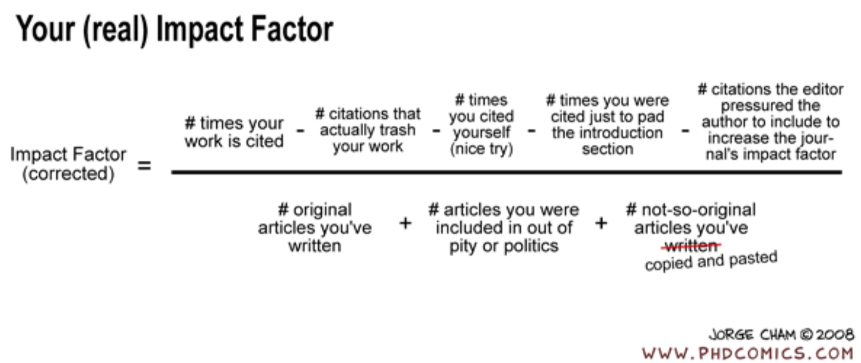
http://www.phdcomics.com/

Slide 22
Alternatives to IF
Reliability-Based Citation Impact Factor
Source Normalized Impact per Paper (SNIP)

Slide 23
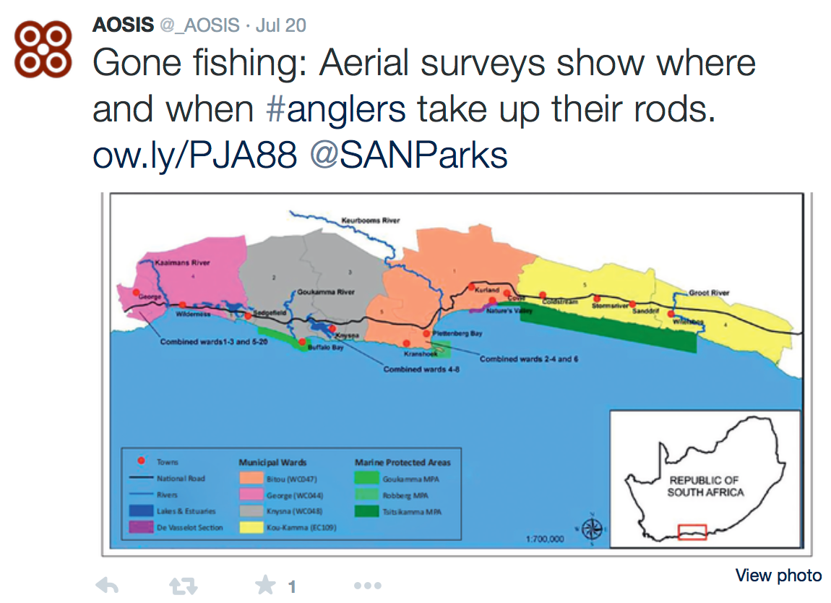
Social Media - Twitter

Slide 24
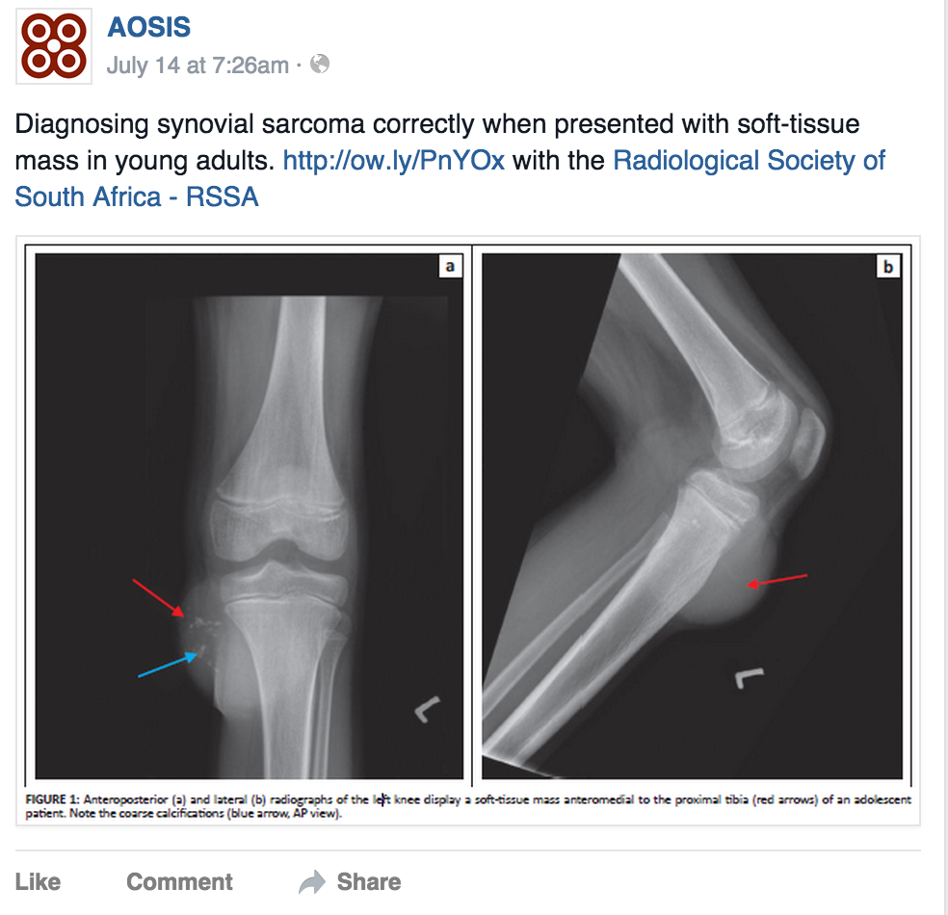
Social Media - Facebook

Slide 25
Article level metrics
DOI links
Social media, newspapers

Slide 26
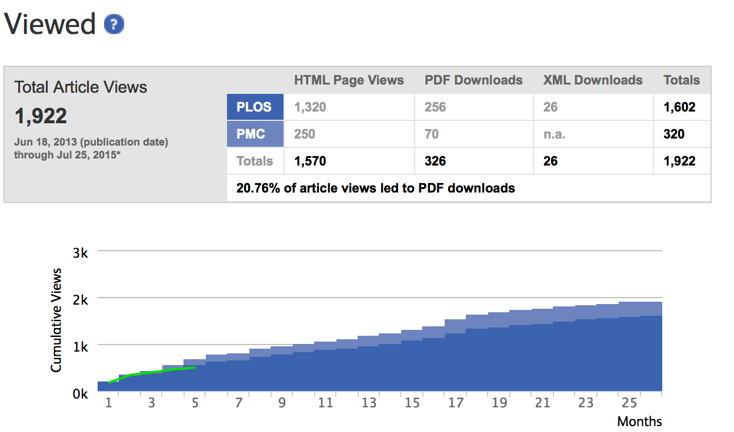
Altmetrics example
The Observation of Highly Ordered Domains in Membranes with Cholesterol
Clare L. Armstrong et al. June 18, 2013
DOI: 10.1371/journal.pone.0066162

Slide 27
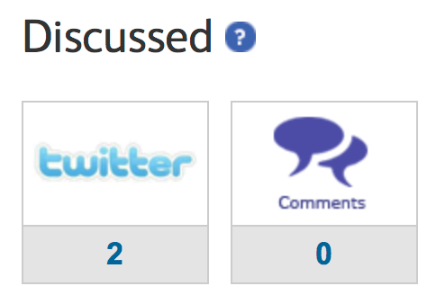
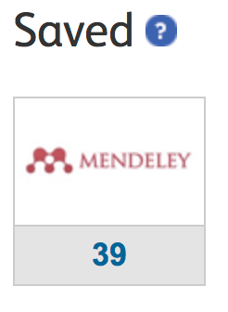
Altmetrics example
The Observation of Highly Ordered Domains in Membranes with Cholesterol
Clare L. Armstrong et al. June 18, 2013. DOI: 10.1371/journal.pone.0066162

Slide 28
R&D spending South Africa
Total spend 2012/13: R23.871 Bln ( 2,6% real)
Public spending = 54%
GERD ratio 0,76% of GDP (target 1%), same for 3 years
http://www.hsrc.ac.za/en/media-briefs/cestii/research-and-development-survey-released

Slide 29
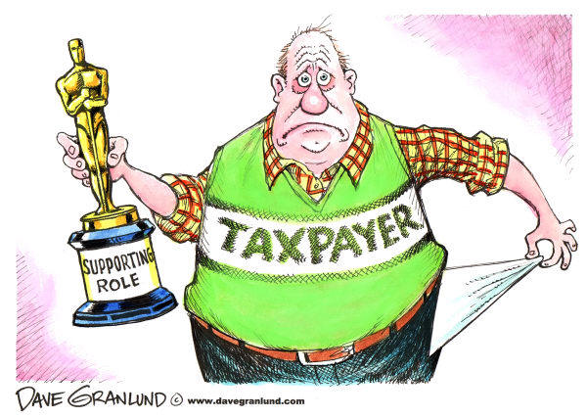
RSA Taxpayer - vested interest
The taxpayer is funding more than 50% of research in South Africa, more that R20 billion per year
Results?

Slide 30
Impact of Open Access on Research
Wider audience - “Local journals” become international, even if not indexed (Google) - Supported by social media
Increased productivity (faster) of research (data)¹
Impact² - “freely available articles do have a greater research impact” (citations)
Quality - “Predatory journals” & “high jacked journal” - Evaluating Open Access Journals (Ryerson univ.)³
1. http://crln.acrl.org/content/73/2/83.full
2. http://crl.acrl.org/content/65/5/372.short
3. https://library.ryerson.ca/services/faculty/scholarly-communication/evaluating-open-access-journals/

Slide 31
Thank you

